Slide 1
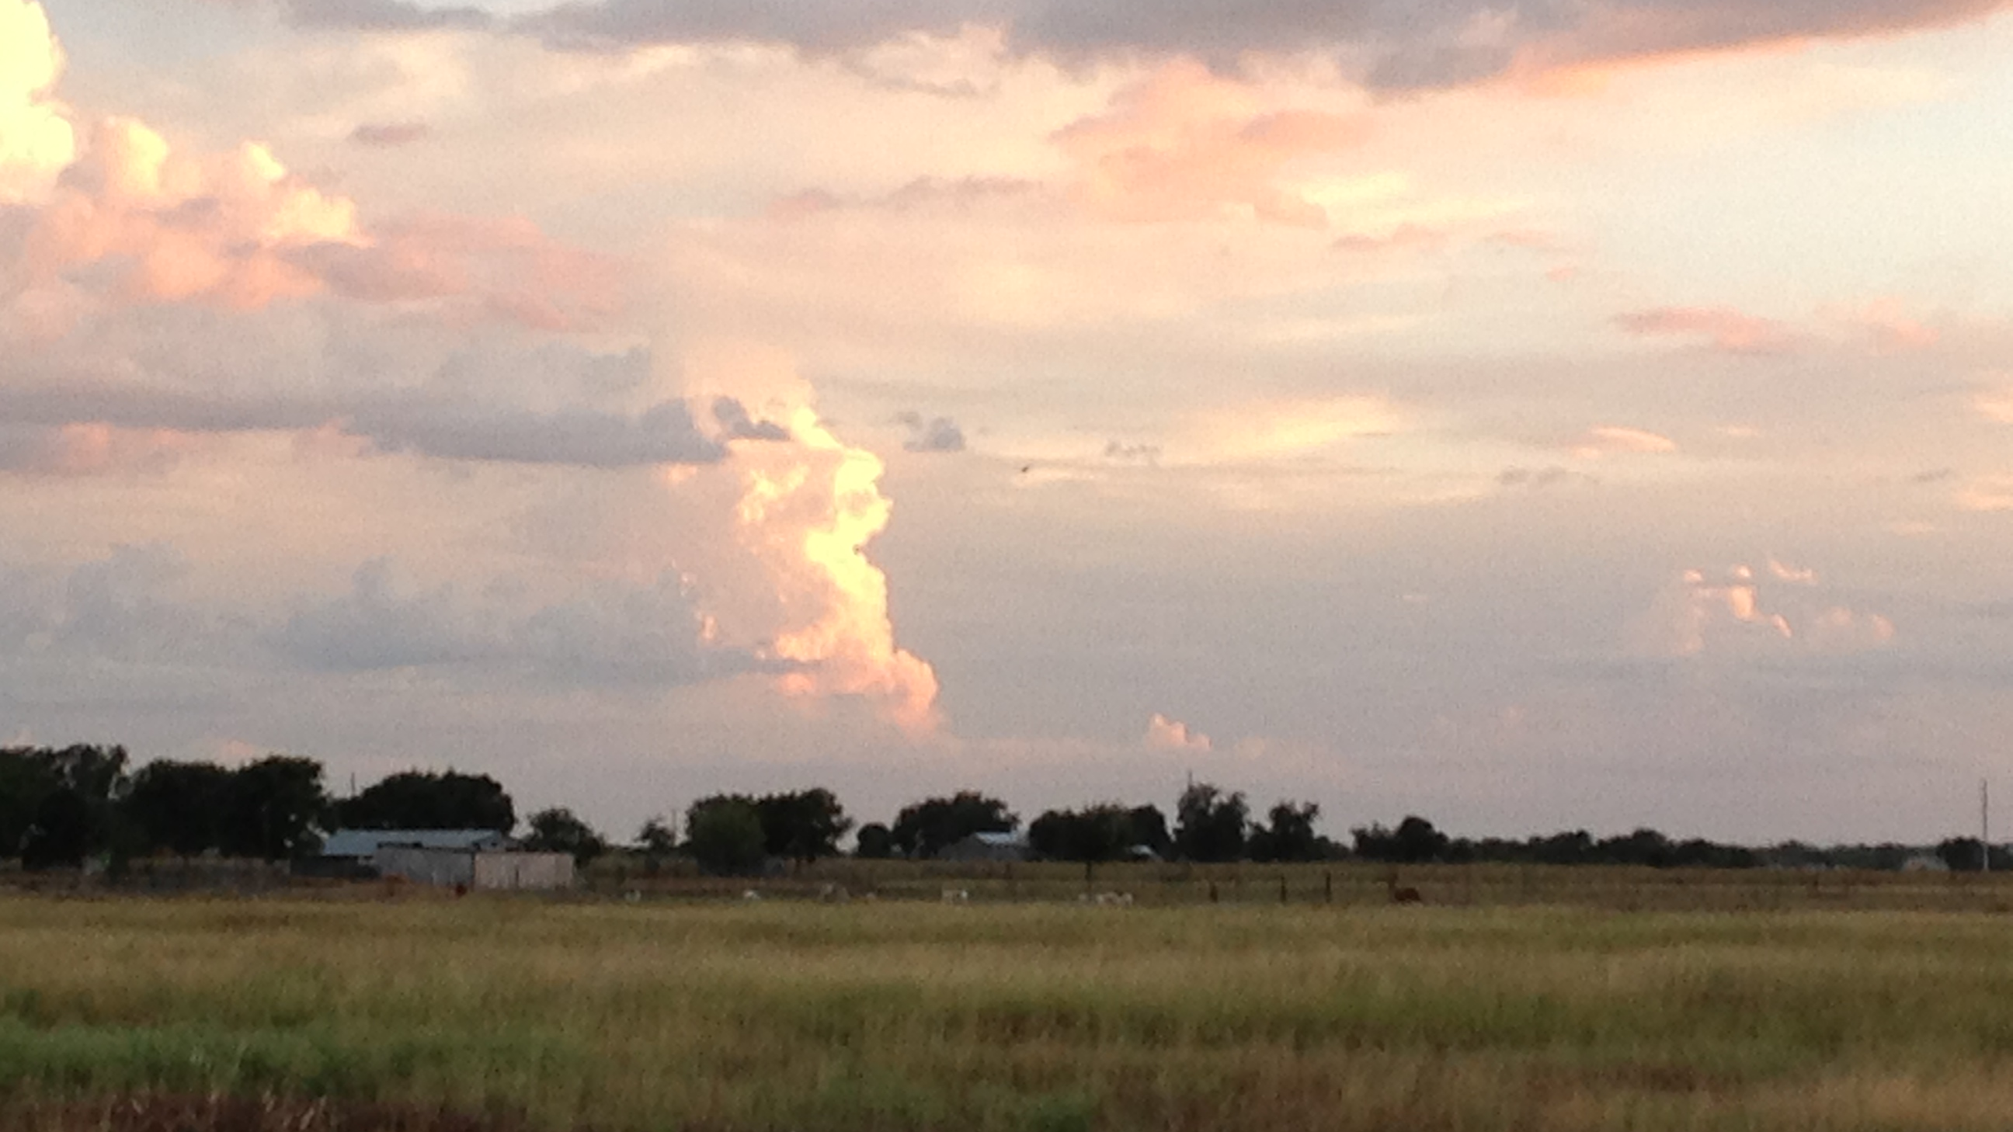
Re-conceptualizing the EAA Recharge Program for Optimizing and
Protecting the Beneficial Use of the Edwards Aquifer
July 11, 2017
J. Mark Hamilton, P.G.
Executive Director, AMS
and
James Boenig, P.E.
Director, Aquifer Protection

Slide 2
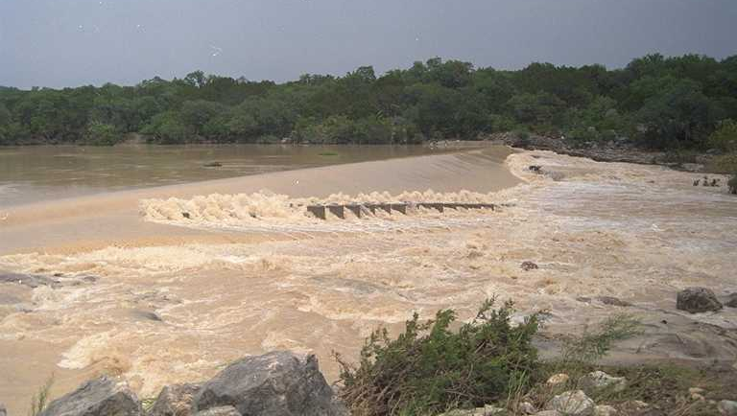
Presentation Overview
Physical Characteristics of the Edwards Aquifer
History and Evolution of the Recharge Program
Status of Region-wide Water Planning
Aquifer Optimization Strategies
Staff Recommendations

Slide 3
Aquifer Characteristics, Hydraulics
The Edwards Aquifer
  Karst, rapid response to recharge.
    Aquifer responds rapidly to significant rainfall events.
    Annual recharge estimates range from 43,700 AF to 2,485,700* AF for POR.
    System is more limited by rainfall amounts than ability to accept recharge.
  Karst, rapid response to discharge (and drought).
    Aquifer will drain from “full” to Stage III in about two-years, without adequate rainfall.
    Difficult to count on a firm yield during persistent drought.
    For the POR, discharge due to springflow averages just over half of total discharge.
*Indicator of natural recharge efficiency

Slide 4
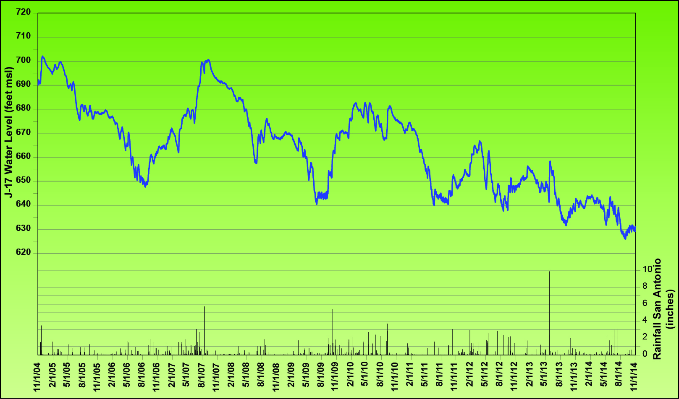
Aquifer Hydraulics Response to Rainfall
September 2006 – September 2007
+51 feet in 12 months

Slide 5
Aquifer Hydraulics
Response to Rainfall
July 2009 – March 2010
+40 feet in 8 months

Slide 6
Aquifer Hydraulics
Response to Rainfall
July 2011 – April 2012
+21 feet in 6.5 months

Slide 7
Aquifer Hydraulics
Response to Drought
December 2004 – September 2006
-53 feet in 20 months

Slide 8
Aquifer Hydraulics
Response to Drought
September 2007 – July 2009
-61 feet in 22 months

Slide 9
Aquifer Hydraulics
Response to Drought
October 2010 – July 2011
-41 feet in 20 months

Slide 10
Aquifer Hydraulics Summary
  The aquifer responds rapidly to both recharge and discharge.
  Springflows are proportional to water level, the system drains at a higher rate when water levels are high.
  The system is more rainfall limited than recharge limited.
  Record recharge of over 2.4 million acre-feet in a single year provides an indication of recharge efficiency

Slide 11
Aquifer Characteristics and Firm Yield
Firm Yield:
The dependable supply of water available during a repeat of the drought of record (1947-1956) 10 years.

Slide 12
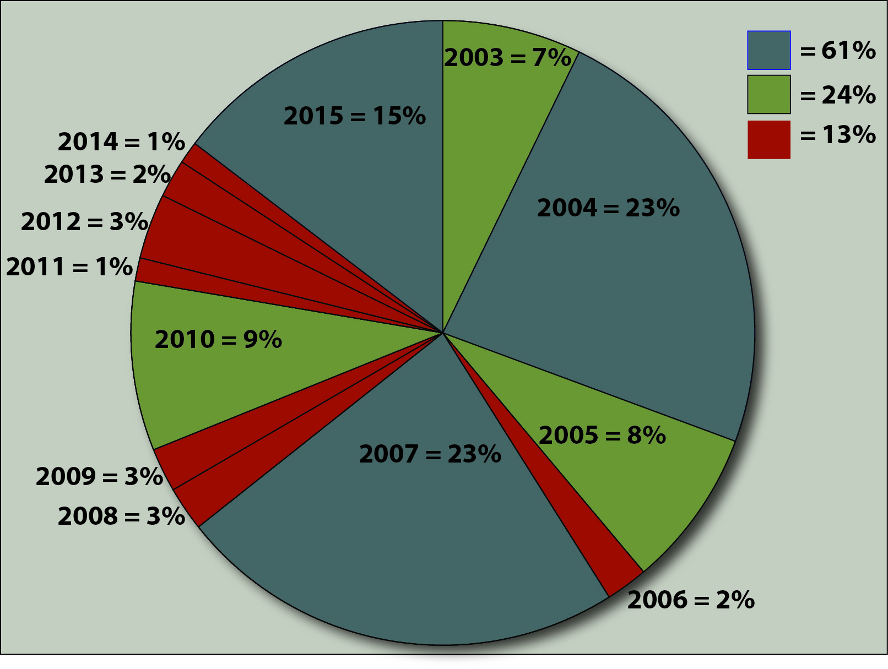
Importance of
Firm Yield
Percent of Total Recharge
13-year period ending
December 31, 2015
We will typically have a
wet year in most 10-year
Periods.
But, consecutive dry years
have significant impacts on
water levels.

Slide 13
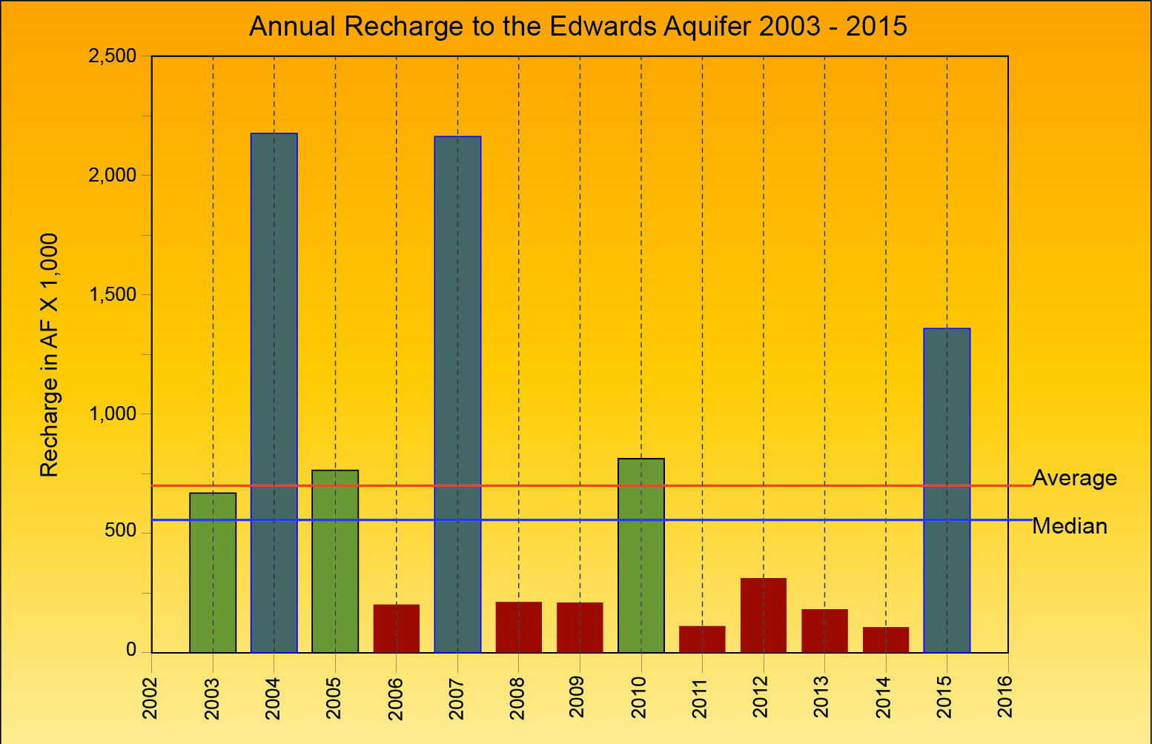
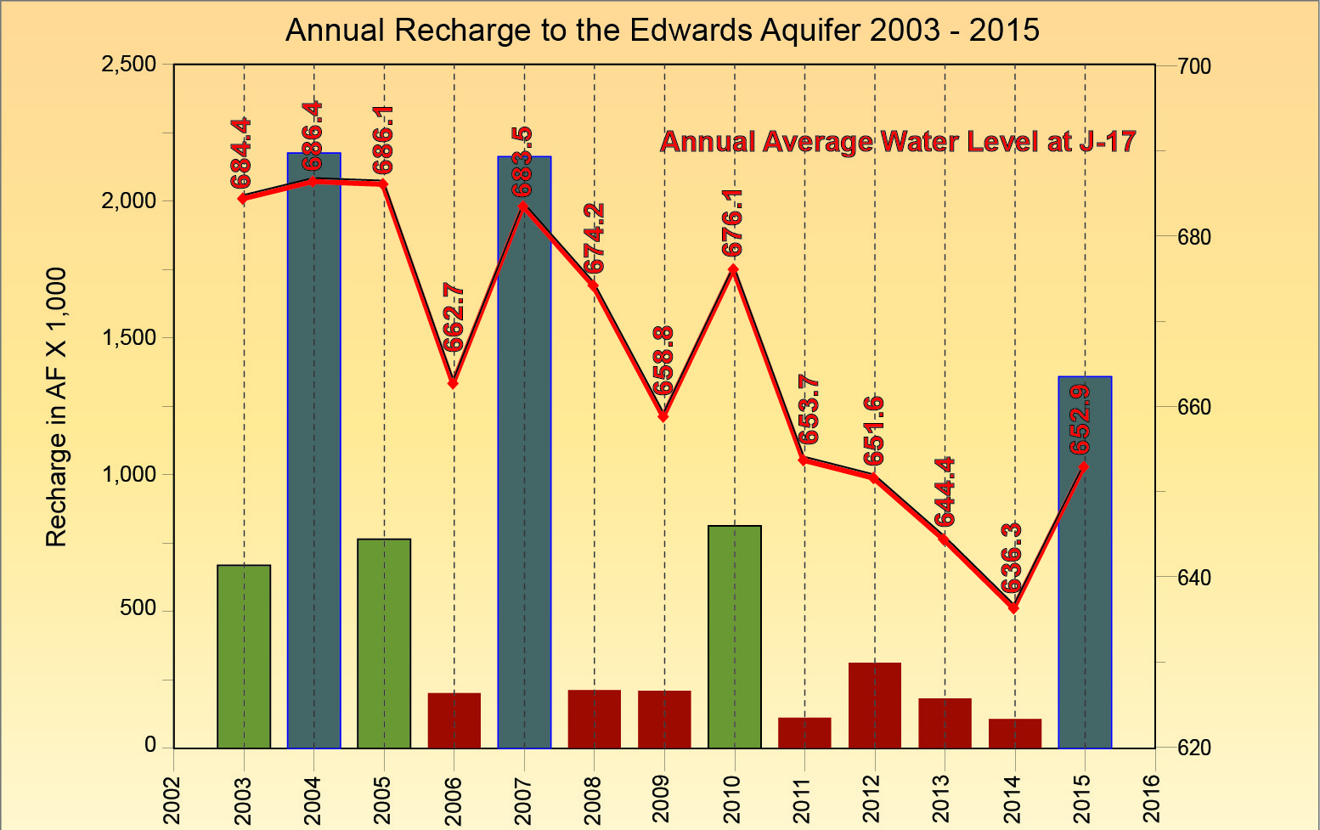
What if 2015 had been dry?
700,200 AF
557,010 AF

Slide 14
History of the EAA Recharge Program
The Program was implemented by the EUWD.
    To “enhance” recharge, given the technological and regulatory tools available at the time.
Resulted in constructing four dams located in Medina County.
  1974 – Parkers Creek
  1978 – Verde Creek
  1979 – San Geronimo Creek
  1982 – Seco Creek

Slide 15
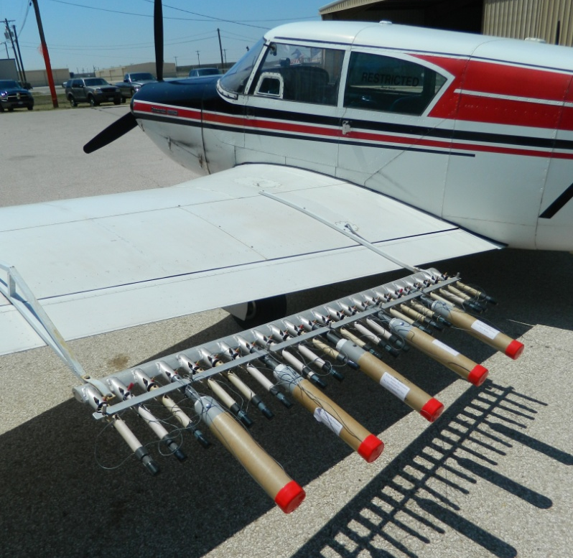
Program Evolution
Recharge as defined in the EAA Act:
Increasing the supply of water to the aquifer by naturally occurring channels or artificial means.
By this definition, the difference between today’s recharge program and 1997 is the addition of Precipitation Enhancement.

Slide 16
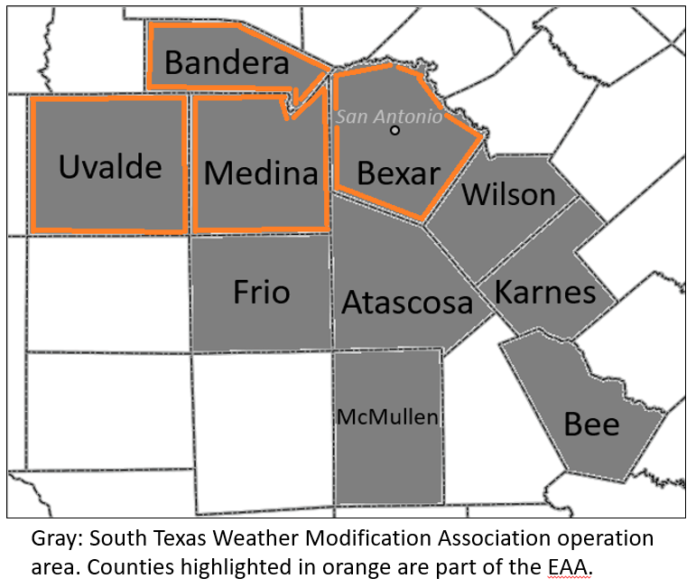
Program Evolution
Precipitation Enhancement Program
  Average annual recharge 2004 - 2015 = 3,180 AF/yr.
  PEP also contributes to demand reduction in affected areas.
On average, EAA’s Recharge Program contributes about 6,500 AF/year of additional recharge. (Average from dams + average from PEP)
The drawback to both of these tools is a lack of effectiveness in dry years.

Slide 17

Program Evolution
Optimization:
An act, process, or methodology of making something as fully perfect, functional, or effective as possible.
Perhaps a more effective way to view the Recharge Program is as a tool in the Optimization toolbox.

Slide 18
Program Evolution – Optimization and Protection
The Toolbox:
SAWS ASR: ≈80,000 AF in storage by 2018 (EAHCP).
VISPO: ≈40,000 AF of irrigation water taken out of use in severe drought.
NBU ASR: Pilot study for ASR in Edwards Saline Zone (≈7,000 AF).
Edwards Aquifer Protection Program – maintaining historical recharge.
  145,000 acres and growing, designed to maintain water quantity and quality.
  Abandoned well initiative – assign risk and address abandoned wells.
NRCS State Resource Concern Program – contributing to water quality.
  Riparian and soil health, sediment control.
  Brush management, range planting, well plugging.

Slide 19
Program Evolution – Optimization and Protection
The Toolbox:
The EAA Act:
  Staff estimates the Act is responsible for a savings of 2.6 million AF of water between 1997 and 2014*.
  This averages about 153,000 AF/yr for the period.
  We witnessed the impacts of the Act on springflow and aquifer levels in the recent drought.
  Highly effective tool for maintaining aquifer levels and springflows.
    Tool was not available to the EUWD
  *The EAA Act: A Success Story, numbers based on savings from pumping growth predicted to occur without the Act, increased population, Act related cap, permit system, and conservation measures.

Slide 20
Can We Improve our Optimization Strategies?
Yes – if we can effectively increase the residence time of water in the system.
Goal – Increase Firm Yield
HOW?
Currently, ASR appears to be the most effective tool.

Slide 21
Summary
Average Recharge from Dams
  ≈3,300 AF/yr (enhanced R) Without Seco – the average drops to ≈2,300 AF/yr
Average Recharge from PEP
  ≈3,200 AF/yr
Benefits from other Optimization and Protection tools:
  EAHCP ASR contributions about 84,000 AF.
  VISPO about 40,000 AF.
  Potential new ASR estimated at 7,000 AF.
  EAA Act average of about 150,000 AF/yr.
  Maintaining natural/historical recharge through the EAPP.
  Maintaining water quality through EA SRC and other EAA programs.

Slide 22
Summary
The aquifer will accept a very high percentage of rainfall as recharge.
The system is more rainfall limited than recharge limited.
The Recharge Program – is effectively a tool in the Optimization toolbox.
The EAA Act, ASR, and VISPO, are also tools that help provide certainty for the region.
Other programs are designed to protect natural recharge and water quality.

Slide 23


Status of Region-Wide Water Planning
  Region L Planning Criteria
  New Water Supply Sources
  Edwards Aquifer Management Strategies
Notes:
Lets take a look at the regional water planning process to see what is being done to address future water needs. We are going to review Region L Planning Criteria, review a summary of New Water supply sources over the next 50 years, and look at how current EA management strategies add to the Firm Yield of the Aquifer.

Slide 24
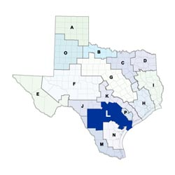
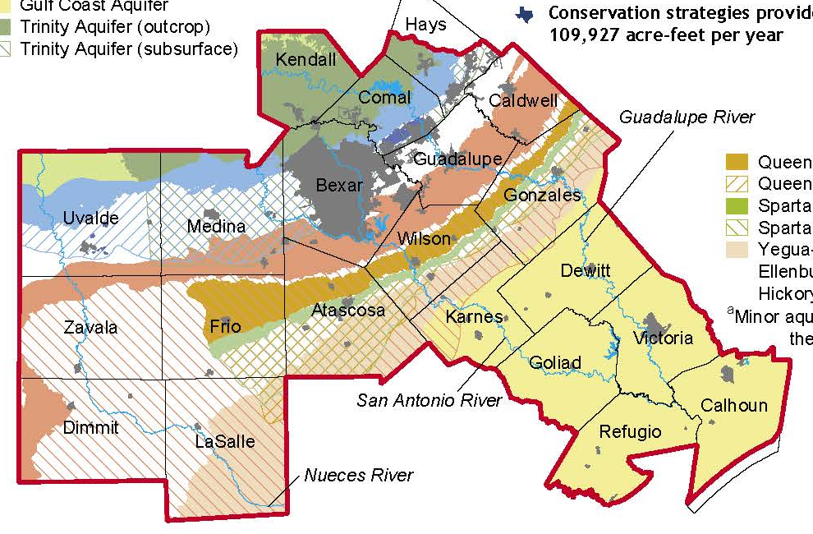
Region L – Planning Criteria
Regional stakeholders rank proposed water supply projects that best meet our future water needs.
50 year planning horizon with Plan updated every five years (2016 Plan Submitted)
Water availability is based on repeat of the drought of record (1947-1956).
Project sponsors provide potential sources of funding for implementation and maintenance.
Future TCEQ and TWDB regulatory and financing decisions shall be consistent with approved regional plans.
Notes:
Our Region L water planning boundary contains 21 diverse counties and 3 major river basins. Water planning in the region is particularly complex because of the intricate relationships between the region's surface and groundwater resources.
The basis of the stakeholder Planning process is to: assess projected water demands, and existing supplies, in order to calculate potential shortages. And then to Evaluate a proposed water management strategies, and Recommended a prioritized list of capital projects that best meet our future water needs.
The Planning process looks at 50-year timeframe and the plan is updated every 5 years. Current and proposed supplies are evaluated based on Firm Yield which is the average amount of water that the proposed project would produce during the 10-year long drought of record from 1947 to 1956.
For a proposed project to be considered, the plan must have a sponsor who develops a conceptual plan and agrees to design, implement and operate the project. With a sponsor in place, TWDB provides funding for the project conceptual feasibility study. After the feasibility study is complete, the planning group then scores the project on several factors including sustainability and cost effectiveness to receive a ranking among all the other proposed projects. If the project receives a high score it will have a better chance of getting funding assistance from the State for continued design and implementation. Conversely, if a project does not go through the Region L process, it still may be possible to build but will have no chance for State regulatory or financial assistance.

Slide 25
Region L: Water Demands and Additional Needs
Year | 2020 | 2070 | Increase
Population | 3,001,465 | 5,192,028 | 73%
Demands | 1,070,354 | 1,433,835 | 34%
Total Addit. Need | (200,071) | (482,943)
Sector |  | Addit. Need | % of Ttl
Municipal |  | (285,084) | 59%
County |  | (19,080) | 4%
Manufacturing |  | (40,034) | 8%
Mining |  | (666) | 0%
Steam Elect Power |  | (70,696) | 15%
Livestock |  | 0 | 0%
Irrigation |  | (67,383) | 14%
Notes:
The planning process itemizes the demands and additional needs of all user groups in the region – in the categories listed here. By 2070, the population growth is anticipated to be 73% with an increase in demand of 34%. The additional needs for Region L by 2070 are estimated to be 482,943 acft/yr. The Municipal sector demands show the biggest additional need at 59% of the total.

Slide 26
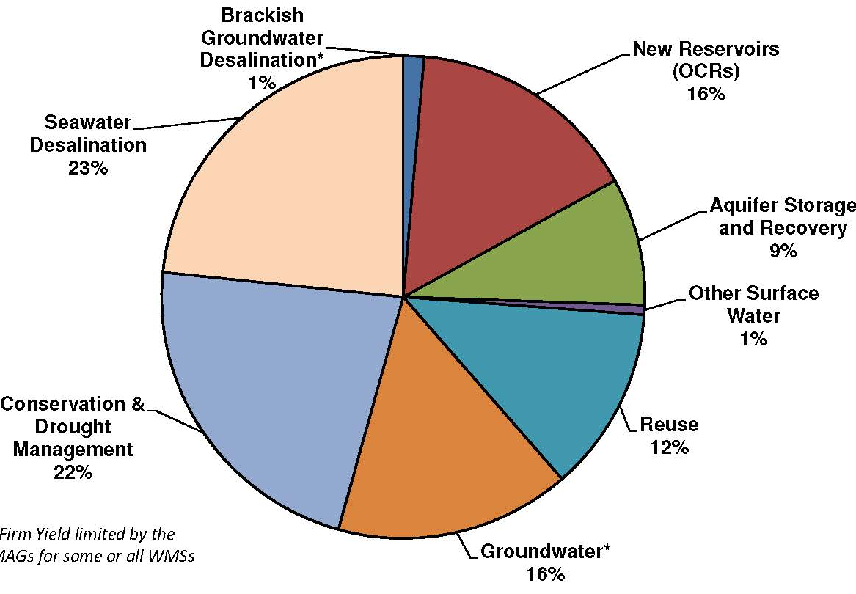
Region L - New Water Supply Sources – 2070
Proposed strategies could produce new supplies of 787,000 acft/yr in 2070. (estimated need is 482,943)
Project Costs (in 2013 dollars)
  Range: $140 - $5,032/acft/yr
  Average cost: $1,291/acft/yr
  Total Capital cost: $10.22 Billion
Example Projects:
  Import Groundwater acft/yr $/acft/yr
  SAWS Vista Ridge- 50,000 $1,645
  Brackish Groundwater
  Brackish Wilcox (SAWS)- 13,442 $1,289
  New Reservoirs (off-channel)
  GBRA Lower Basin Storage- 51,800 $140
  ASR
  GBRA Mid Basin Project- 50,000 $1,637
  Seawater Desalination
  SAWS Seawater Desalination 84,023 $2,713
Sea Wtr 23%
Storage 26%
Conserv 22%
Reuse 12%
Non EA 17% Grndwtr
(Non-Edwards)
Notes:
The pie chart is a summary of 2016 Region L water plan strategies to produce new water supplies of 787,000 acft/yr by the year 2070. The plan intentionally includes the contingency above the estimated need, because of risks involved with implementing water supply projects. There is a large range in project costs from $140 to $5,032 per acre foot with the average cost estimated at $1,291. The total cost of these projects (Region L only) is $10.2 B. All of these costs are in 2013 dollars. The largest category for new water supply sources is
Storage strategies (off-channel reservoirs, ASRs) @ 26%. Followed by
Seawater Desalination – 23%
Conservation & Drought Management – 22%
Non-Edwards groundwater (fresh and brackish) – 17%
Water Reuse – 12%
I have also included selected projects within each category to show examples of firm yield capacity and cost. Note that the $140/acft cost of the GBRA Lower Basin storage project is raw at the basin so treatment and distribution costs for potable use are not included.

Slide 27
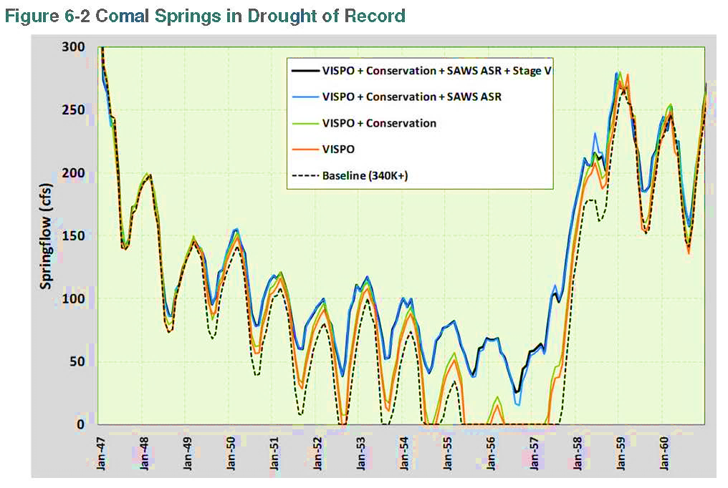
Management - EAHCP: Phased implementation of pumping restrictions during critical periods.
Level 1 – VISPO – 40,000 acft/yr
Level 2 – Conservation Measures – 10,000 acft/yr reduction in Edwards municipal uses
Level 3 – SAWS ASR – 50,000 acft/yr in new leases and offsets with stored water.
Level 4 – Critical Period Stage V – 44% reduction in permitted Edwards pumping
Result: These four Plan components raise the Firm Yield of the Aquifer 50,600 acft/yr at a cost of $345/acft/yr
Notes:
Two Edwards groundwater management strategies increase the Firm Yield of the Aquifer. The first, the HCP management strategy, reduces withdrawals from the aquifer during critical periods.
This graph shows the results of a computer model to illustrate incremental improvement in maintaining flow at Comal Springs during the drought of record as each level of the HCP plan is implemented. The Region L evaluation process determined that this strategy increases the Firm Yield of the Aquifer by 50,600 acft at a cost of $345/acft/yr.
This strategy provides a significant increase to the firm yield of the Aquifer at an economical price.

Slide 28
Management - Edwards Transfers: Allows permit holders to sell or lease up to 50% of their initially permitted irrigation rights.
In the 2016 Region L Plan, Edwards transfers are included to meet the projected needs of 16 municipal water groups.
Projected Firm Yield needs are;
  5,972 acft/yr in 2020 and
  11,772 acft/yr in 2070.
The cost of these transfers is a negotiated price based on the “replacement cost” of water assumed at $1,415/acft/yr.
Notes:
The second strategy is Edwards Transfers made trade between willing buyers and sellers of groundwater rights that were initially permitted for irrigation.
This management strategy is currently used to meet the projected needs of 16 municipal water groups that draw from the EA. The increase in firm yield estimated by these transfers in appx 6,000 in 2020 and almost doubled, near 12,000 acft/yr in 2070.
The cost associated with these transfers is negotiable and flexible to a purchase or a lease from Edwards permit holders. The Region L process assumes the real cost as the replacement cost of water that is transferred which is $1,415/acft/yr.

Slide 29
Region-wide Water Planning - Summary
Region L plan meets projected demands through 2070 at an average cost of $1,291/acft/yr without increases to the firm yield of the Aquifer
Emphasis has shifted from Aquifer-centered enhancement projects to considering Aquifer water limits as well established and set
Increasing long-term storage is projected to provide 26% of the water demands in the next 50 years
Edwards groundwater management strategies effectively increase the Firm Yield of the Aquifer by over 62,000 acft/yr
The EAA may seek, but is not obligated to enhance the Firm Yield of the Aquifer
Notes:
A summary of the major topics from Region-wide water planning include:
Region L has a plan to meet projected demands through 2070 at an average cost of $1,291/acft/yr without additional increases to the firm yield of the Aquifer.
Water planning emphasis has shifted from Aquifer-centered enhancement projects to now considering the available water in the Aquifer as well established and set, (primarily due to the Act and development of state water planning law).
ASR/OCR (long-term storage) projects in the 2016 Region L water plan account for 26% of the new water supplies over the next 50 years. (the concept is that we continue to stockpile water captured during storm events or normal/wet years to withstand longer periods of drought.)
The HCP and Edwards Transfer analysis indicates these groundwater management strategies increase the Firm Yield of the Aquifer by over 62K acft/yr (n 2070.)
The EAA may seek, but is not obligated, to enhance the Firm Yield of the Aquifer. As I understand the Act, the EAA may seek, but is not obligated, to design and implement projects that enhance the water available for withdrawal from the aquifer. We can implement surface or groundwater projects, if the project meets the intent of the EAA mission to manage, enhance and protect the aquifer.
Also, we cannot “unreasonably deny” a project proposed by political subdivisions if the applicant shows competence and the project has potential merit. EAA rules support this process to facilitate these types of project inquiries.
System growth and diversification of non-Edwards water supplies may require future revisions to Aquifer management strategy.

Slide 30
Aquifer Optimization Strategies
  Protect Water Quality
  Update Previous Recharge Enhancement Study
  Review Alternative Water Supply Strategies
Notes:
As we discuss aquifer optimization strategies, I will be covering three primary topics, protect water quality, update the 1998 Trans-Texas recharge enhancement feasibility study, and review some “non-recharge” (or alternative) strategies to enhance the beneficial use of the aquifer.

Slide 31
Optimizing Beneficial Use of the Aquifer
Water Quality
Aquifer Groundwater
  Well canvassing program
  Abandoned Well Plugging Initiative
Aquifer Recharge Water
  Regulated material storage/handling
  Conservation Easements (COSA EAPP)
  Urban BMPs (TCEQ WPAP)
  Agriculture BMPs (EA SRC)
  First Responder Training
Aquifer Research
  Vulnerability Study (EAA)
  Urban BMP Effectiveness Studies (COSA Proposition 1 funding)
Water Quantity
Recharge
  Un-captured surface water leaving the EARZ
  Precipitation Enhancement*
  Protect natural recharge rates
Storage
  Aquifer Storage Recovery (ASRs)
  Off-Channel Reservoirs
  Recirculation and Recharge*
  Rainwater Harvesting*
Management
  EAHCP
  Edwards Transfers
Other
  Edwards Desalination
  Water Reuse
  * Requires further analysis to determine if practice contributes to firm yield
Notes:
This list shows the expanded view of activities for optimizing beneficial use of the aquifer in addition to the more well-known strategies of recharge and management. The list includes protection of Water Quality in addition to strategies to increase the Firm Yield of the Aquifer.

Slide 32
Optimizing Beneficial Use - Water Quality
Water Quality
Aquifer Groundwater
  Well canvassing program
  Abandoned Well Plugging Initiative
Aquifer Recharge Water
  Regulated material storage/handling
  Conservation Easements (COSA EAPP)
  Urban BMPs (TCEQ WPAP)
  Agriculture BMPs (EA SRC)
  First Responder Training
Aquifer Research
  Vulnerability Study (EAA)
  Urban BMP Effectiveness Studies (COSA Proposition 1 funding)
Water Quantity
Recharge
  Un-captured surface water leaving the EARZ
  Precipitation Enhancement*
  Protect natural recharge rates
Storage
  Aquifer Storage Recovery (ASRs)
  Off-Channel Reservoirs
  Recirculation and Recharge*
  Rainwater Harvesting*
Management
  EAHCP
  Edwards Transfers
Other
  Edwards Desalination
  Water Reuse
  * Requires further analysis to determine if practice contributes to firm yield
Notes:
We include protection of Water Quality as a priority in our Program. To protect Groundwater – we focus on the process of locating all Edwards wells and prioritizing the risks of known abandoned wells in efforts to assist landowners in plugging these direct conduits to our groundwater.
In regards to protecting the quality of Recharge Water – we have recently revised our Regulated Materials rules, we assess and monitor 140K acres of CEs and provide assistance in monitoring TCEQ WQ basins. The EA SRC provides additional regional NRCS funding for agricultural BMPs to reduce erosion and water demand. First Responder training is targeted to reduce EARZ impacts due to fires and accidents.
Aquifer Research is working to better understand the water quality relationships of surface water and groundwater.
The EA SRC and EAPP programs are water quality based programs that also protect natural recharge rates.

Slide 33
Optimizing Beneficial Use - Recharge
Water Quality
Aquifer Groundwater
  Well canvassing program
  Abandoned Well Plugging Initiative
Aquifer Recharge Water
  Regulated material storage/handling
  Conservation Easements (COSA EAPP)
  Urban BMPs (TCEQ WPAP)
  Agriculture BMPs (EA SRC)
  First Responder Training
Aquifer Research
  Vulnerability Study (EAA)
  Urban BMP Effectiveness Studies (COSA Proposition 1 funding)
Water Quantity
Recharge
  Un-captured surface water leaving the EARZ
  Precipitation Enhancement*
  Protect natural recharge rates
Storage
  Aquifer Storage Recovery (ASRs)
  Off-Channel Reservoirs
  Recirculation and Recharge*
  Rainwater Harvesting*
Management
  EAHCP
  Edwards Transfers
Other
  Edwards Desalination
  Water Reuse
  * Requires further analysis to determine if practice contributes to firm yield
Notes:
As we discuss the topic of Recharge, I will update the 1998 Trans-Texas recharge feasibility studies to current costs and capacities. These are in-channel dams designed to capture and recharge surface water that would have otherwise left the EARZ.
The other two topics under Recharge were previously discussed.

Slide 34
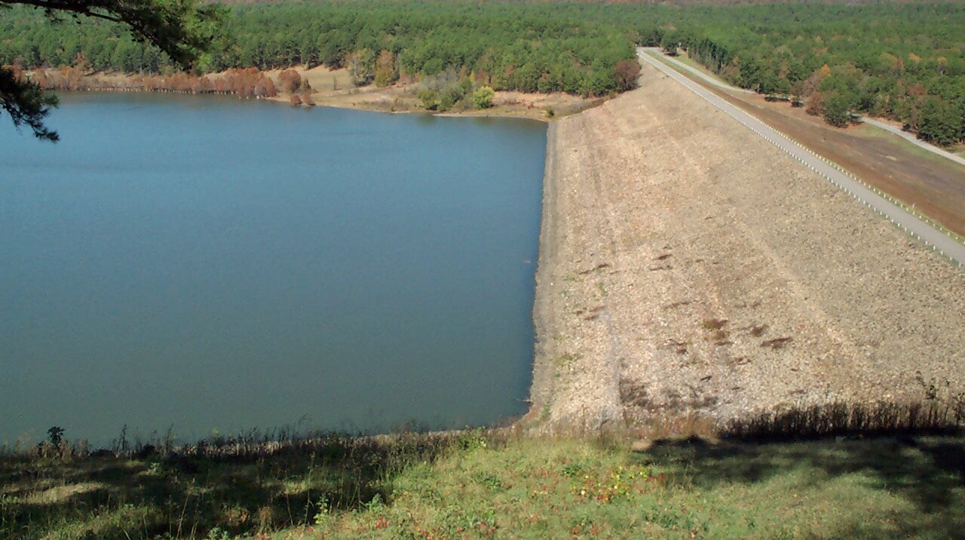
Development of Capital and Annual Project Cost
Total Capital Cost
  Dam, Spillway, and Appurtenant works
  Diversion Dam, Pump Station, & Pipeline (if required)
  Road Relocations
  Land Acquisition
  Environmental Mitigation
  Engineering, Legal, Financial, Administration, Misc.
Total Annual Cost
  Amortized Capital Cost (40 yrs. @ 5.5%)
  Operations and Maintenance (annual)
  Water Rights Mitigation (annual)
Notes:
Cost updates to the 1998 study were made for both the total capital cost and the total annual cost of the project. Capital cost includes road relocations, land acquisition, site mitigation, and engineering, legal, financial, and administration costs, in addition to construction of the dam.
Total annual costs include debt financing, O&M, and payment for replacement of downstream water rights impacted by the project.

Slide 35
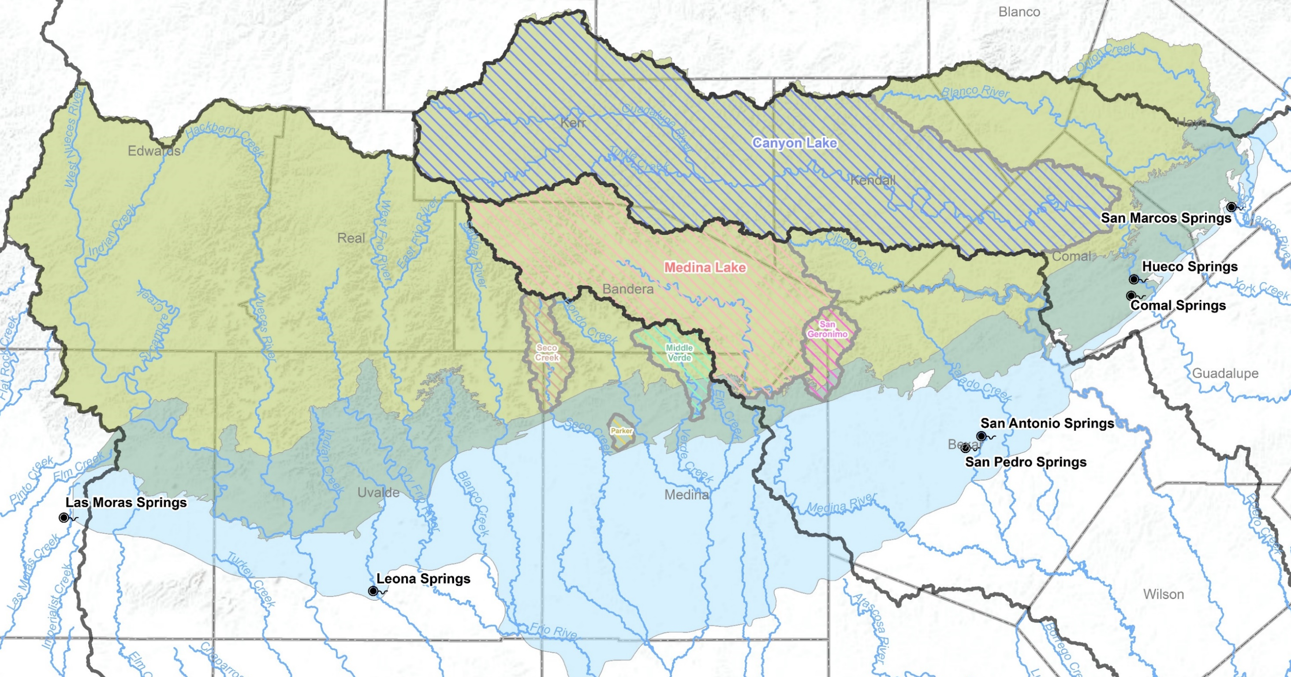
Watersheds of Existing Dams
Notes:
This map shows the 3 major river basins outlined in the heavy black line. This was the existing watershed map used for recharge dam feasibility studies conducted from 1988 to 1998. The map outlines the watershed boundaries of the 4 existing EAA dams (Seco, Parkers, Middle Verde, and San Geronimo), Medina Lake and Canyon Lake. Canyon and Medina have large dams on the contributing zone that impound large volumes of runoff in a conservation pool for water supply and recreation while also providing sufficient additional storage for flood reduction.

Slide 36
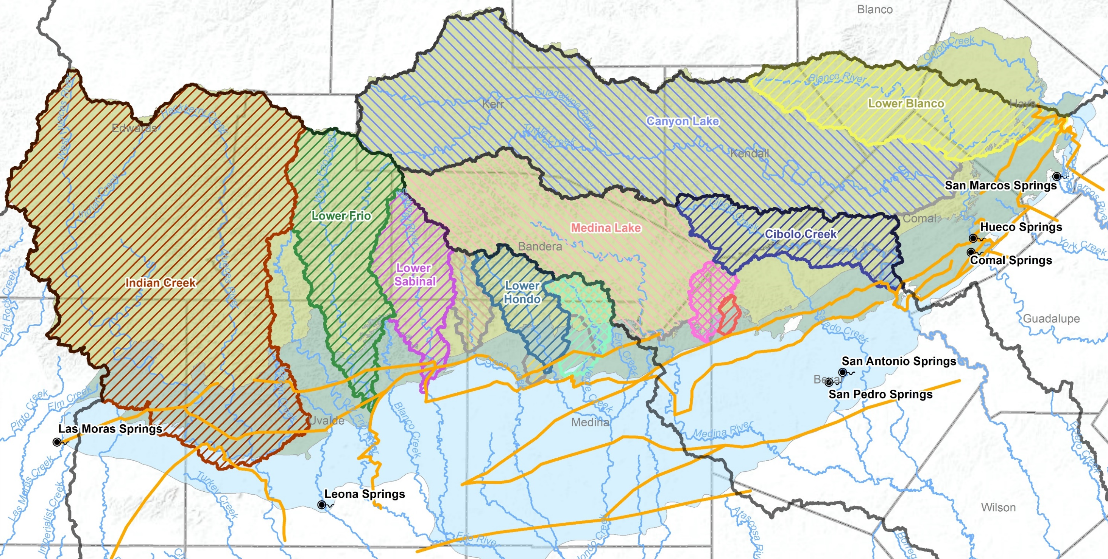
Watersheds of Existing and Trans-Texas Proposed Dams
Knippa Gap
Haby’s Fault
Notes:
This map adds watersheds of the T-T recharge projects shown with the NE hatching. Although many sites were initially considered (including structures upstream of the RZ), the analysis found that structures situated at the downstream edge of the RZ on major streams were the most cost efficient sites.
The only significant CZ area without a proposed project is the Dry Frio watershed. The study found that large rates of natural recharge in the Dry Frio River keep an enhancement project from being feasible. The proposed Trans-Texas projects increase the percentage of land in the CZ draining towards a dam from 41 to 93%, and from 22 to 62% in the RZ.
The Indian Creek project dam, is actually on the Nueces River just below the Indian Creek confluence. It has a watershed several hundred square miles larger than Canyon Lake’s watershed.
The map also includes the aquifer’s major hydraulic barriers (shown in gold) to identify project location in relation to the Knippa Gap and Haby’s Fault.

Slide 37
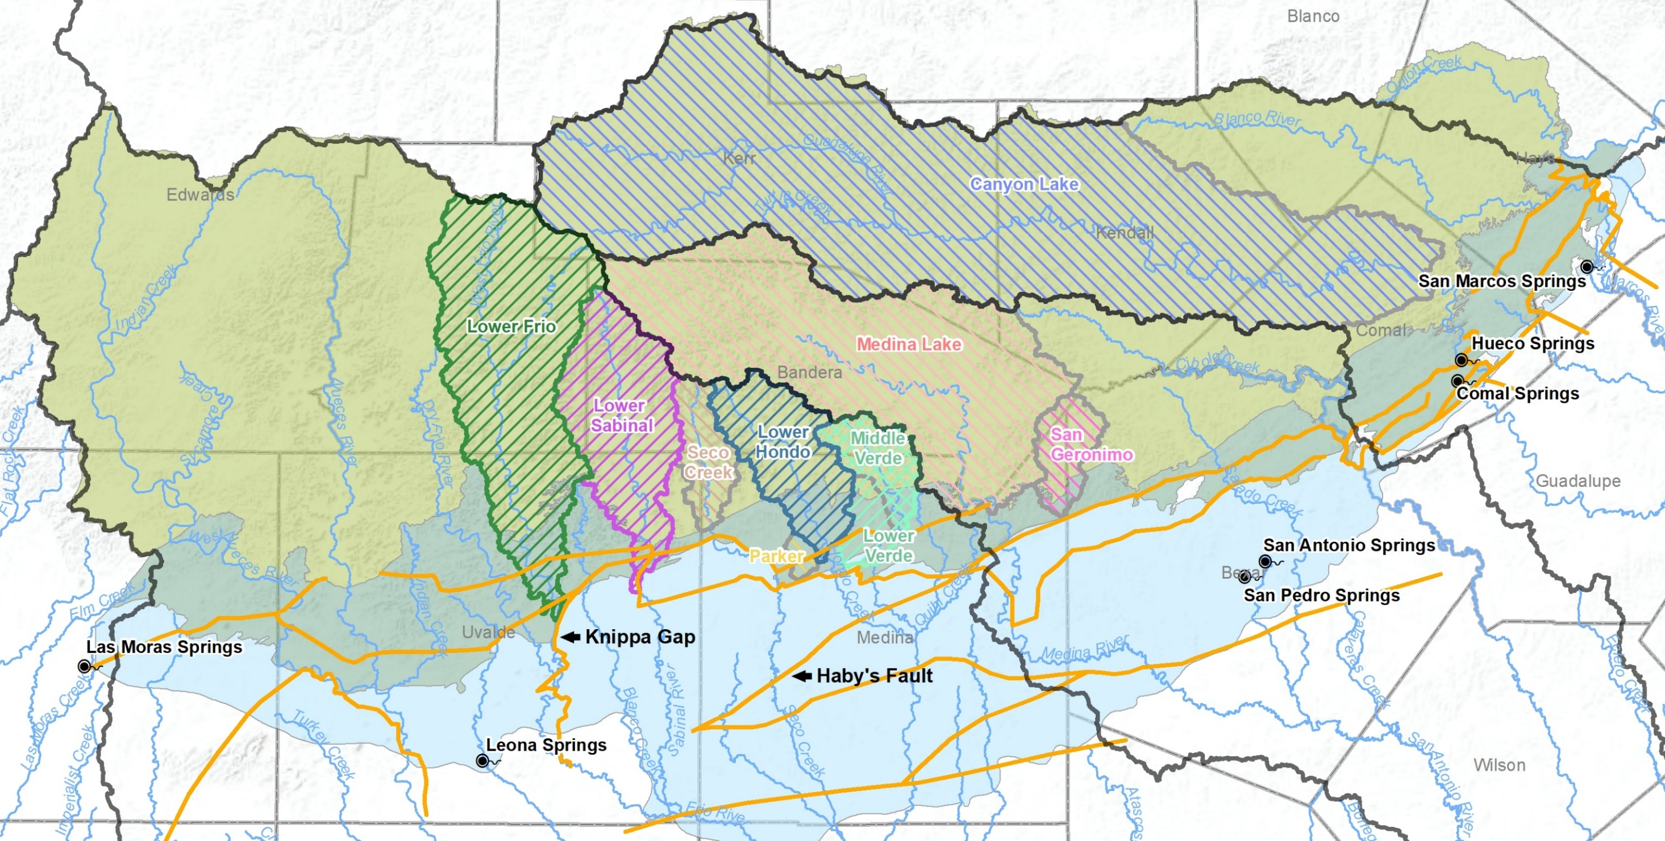
Watersheds of Existing and Package 2c Dams
Notes:
This map shows the watersheds of recharge projects that are still considered feasible today. All sites are in the Nueces River Basin – the Lower Frio, Lower Sabinal, Lower Hondo and Lower Verde. These 4 sites provide the best combination of capacity, suitable geology, and location in relation to the aquifer to benefit both consumption and spring flow.

Slide 38
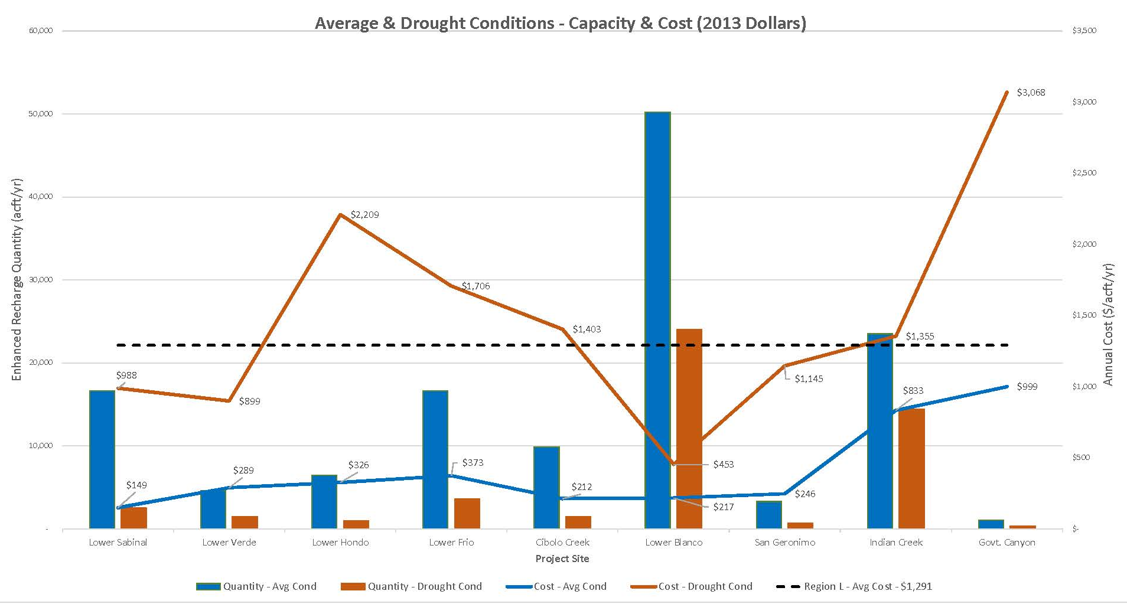
Enhanced Recharge Capacity & Cost:
Ranked by Sustained Yield (SAWS)
Package 2C
Notes:
This graph is a summary of the updated capacities and costs of all proposed T-T projects but includes the 4 prioritized sites in the dashed outline as Package 2C. . The graph shows average condition values in green and drought condition values in brown. Recharge capacities are in columns and unit prices are in lines. Notice that while some projects provide a large percentage of the enhanced recharge volume (such as Lower Blanco), it is located in an area that only benefits the area adjacent to San Marcos springs and received lower priority. The dashed line represents the average cost for additional water in the 2016 Region L water plan ($1,219/acft/yr). Notice that unit costs ($/acft/yr) for average (green) conditions are substantially lower than unit costs during drought conditions (brown).
Notice the substantially higher cost of Govt Canyon recharge (built to include flood control). Also, notice the large difference in recharge quantities and unit prices for average and drought conditions on all projects.
The next slide will show this information in a table.

Slide 39
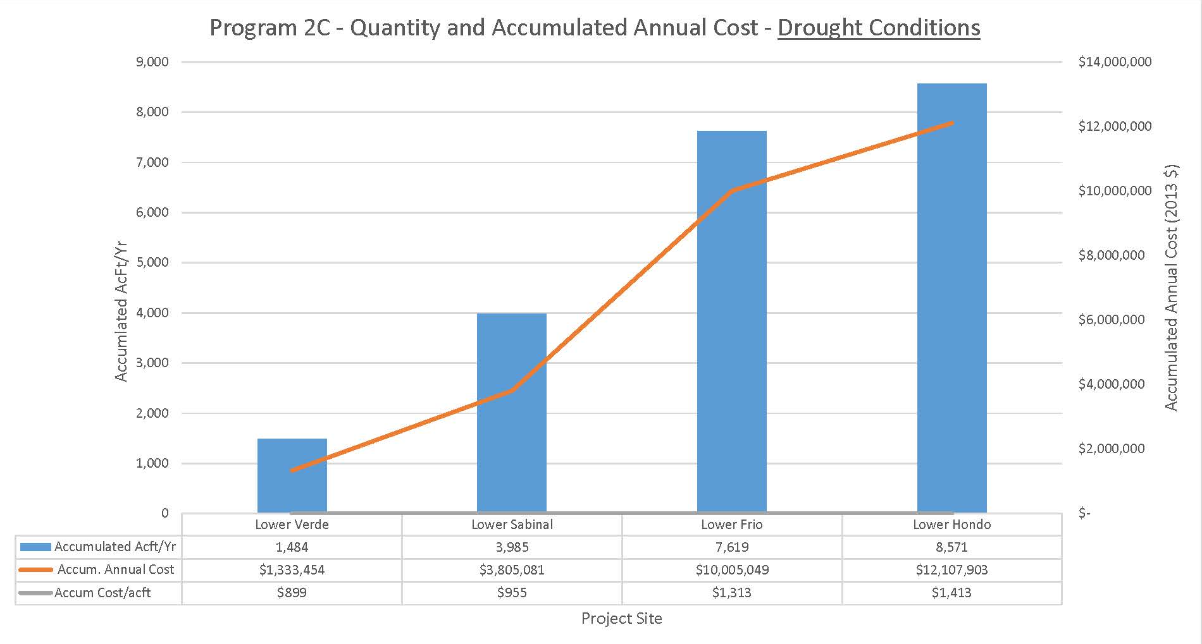
Accumulated Quantity & Cost (Drought Conditions)
Notes:
This chart shows the accumulated enhanced recharge and annual cost (in 2013 $, based on drought conditions) for constructing the 4 projects in Program 2C. Building the 4 projects would require estimated annual costs of $12M of which $9M is debt payments. The average cost of that enhanced recharge during drought conditions is $1,413/acft/yr.

Slide 40
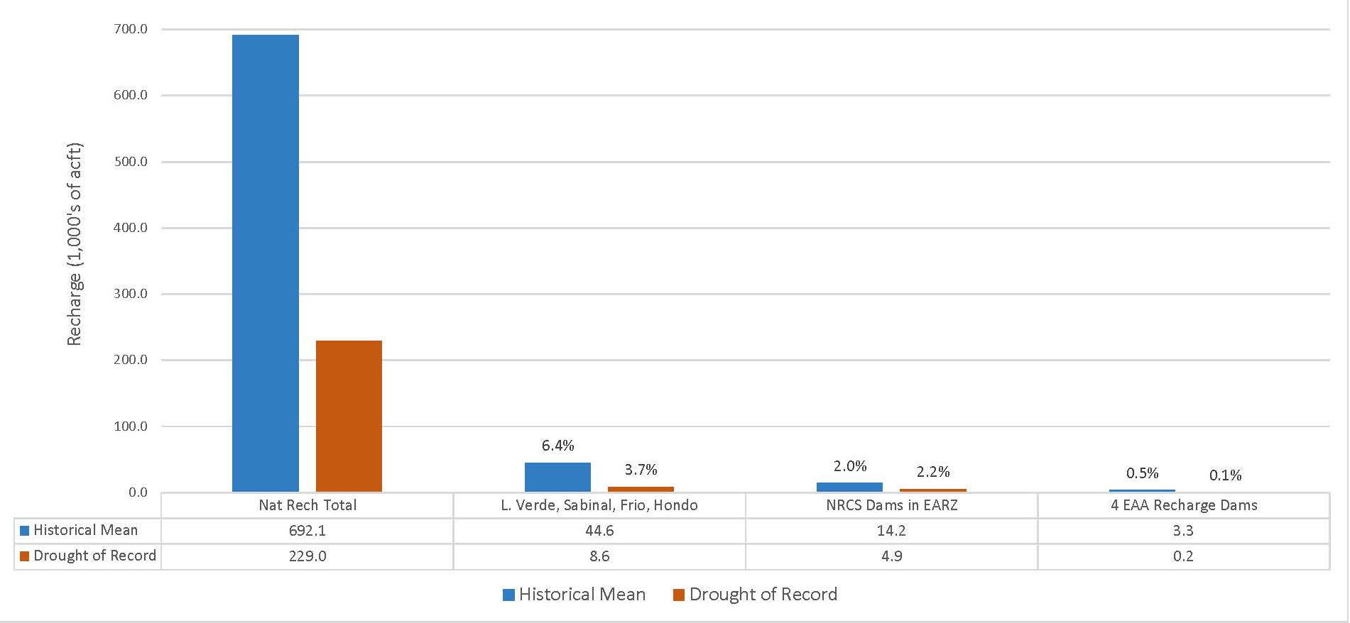
Natural and Enhanced Recharge Project Capacities:
Historical Mean and Drought of Record
Package 2c
Notes:
This graph compares natural recharge capacity of the aquifer during average and DOR conditions to the different recharge dam strategies I have presented. Average conditions are shown in blue and DOR conditions are shown in brown. The percentages shown are in proportion to the natural recharge for average and drought conditions, respectively.
Program 2C is estimated to add 6.4% (44,600 acft/yr) during average conditions and 3.7% (8,500 acft/yr) during the DOR. Note the contributions of the NRCS dams are near 2% for both average and drought conditions (14,200 acft and 4,928 acft) and EAA dams add 0.5% recharge during average conditions and approximately 0.2% during drought.
Generally, the prioritized sites in Program 2C are thought to have the highest efficiency for both withdrawals and Comal Springflow benefits. But the volumes of additional recharge available for withdrawals during drought cannot be predicted with certainty.

Slide 41
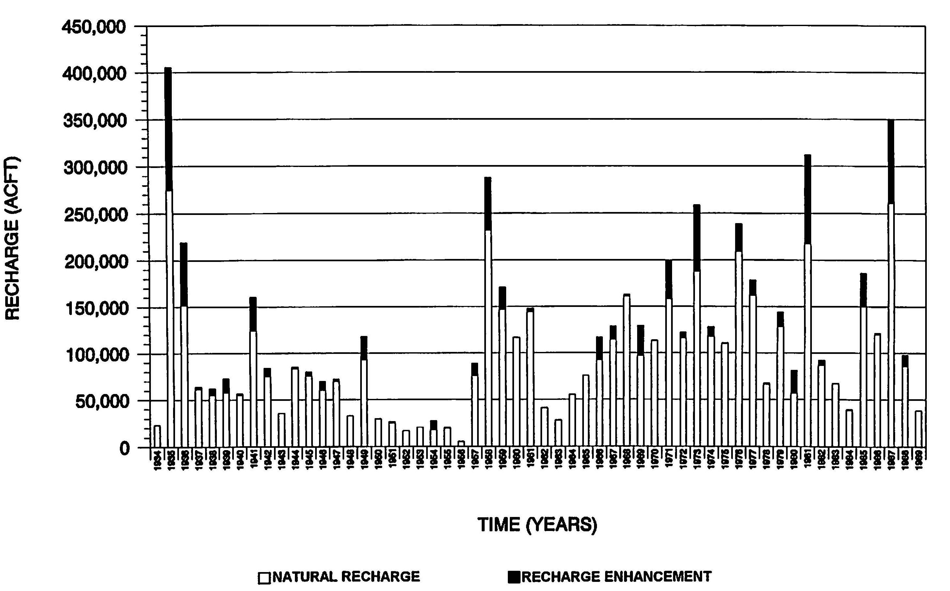
Recharge: Performance During Drought of Record (1947-1956)
10 Year Drought of Record
Lower Frio Creek Project – 1994 (HDR)
Notes:
I include this graph to talk about annual performance vs average performance. This graph from the T-T study illustrates the estimated performance of the proposed Lower Frio Creek project as if it was in place from 1934 to 1989. Natural recharge is shown in white, enhanced recharge is in black. While the average enhanced recharge of the project is estimated to be nearly 4,000 acft/yr, the project did not provide recharge in 41% of those 56 years. Notice that the project provides enhanced recharge in only 3 of the 10 years during the DOR. Although the 10-year long DOR average is the accepted planning standard, take note that enhanced recharge projects have significant levels of variability and uncertainty. Their performance improves when you look at average performance over decades but they might not provide benefit in years when you need them the most. This is especially critical if your long-term system storage is not efficient.

Slide 42

Recharge Project Feasibility: Risk Analysis
Approval/Implementation
  Large investment/Long duration: 10-25 yrs, 15-20% of cost
  Water Rights/Environmental impact mitigation: Regional support required
  Strong, organized opposition: Political will
Technical Function
  Uncertainty of enhanced recharge volume: 8,500 acft/yr, highly variable
  Uncertainty of recoverable amount/duration: 20% - 50%, estimated
  Sedimentation concern at dam sites: Collects non-point pollution
Economic Viability
  Activating recharge “credits” is uncertain: New/Subjective process
  Project funding assistance unlikely: $12M/yr (2013 $)
Notes:
My conclusion to why more recharge projects have not been implemented are centered around Risk analysis. For approval and implementation, a recharge dam project sponsor must be able to risk millions of dollars up-front during the development phase and be totally committed to persevering through strong opposition over a long project schedule.
For Technical Function, the first level of risk is uncertainty in the volume of additional recharge the project captures and the second level of uncertainty is to know how much of that recharged water will physically be available for withdrawals or spring flow when needed. And then there are the environmental concerns of dams including sediment loading of natural recharge features.
Economic viability risk includes the lack of certainty to receive administrative approval for additional withdrawals during drought conditions. And funding assistance from others is unlikely.
Although the unit cost for enhanced recharge dams appear to have some cost advantages over other strategies, the high level of risk and uncertainty associated with dam projects are “hidden costs” and perhaps the larger consideration. Understanding levels of risk associated with recharge dam projects helps me to understand why alternate strategies, somewhat higher in unit cost are selected if the firm yield is more reliable and certain in times of drought. Vista Ridge (50K acft/yr, $2,180) and the Brackish Wilcox Desal projects (13.4K-53.8K acft/yr, $1290).

Slide 43
Optimizing Beneficial Use - Storage
Water Quality
Aquifer Groundwater
  Well canvassing program
  Abandoned Well Plugging Initiative
Aquifer Recharge Water
  Regulated material storage/handling
  Conservation Easements (COSA EAPP)
  Urban BMPs (TCEQ WPAP)
  Agriculture BMPs (EA SRC)
  First Responder Training
Aquifer Research
  Vulnerability Study (EAA)
  Urban BMP Effectiveness Studies (COSA Proposition 1 funding)
Water Quantity
Recharge
  Un-captured surface water leaving the EARZ
  Precipitation Enhancement*
  Protect natural recharge rates
Storage
  Aquifer Storage Recovery (ASRs)
  Off-Channel Reservoirs
  Recirculation and Recharge*
  Rainwater Harvesting*
Management
  EAHCP
  Edwards Transfers
Other
  Edwards Desalination
  Water Reuse
  * Requires further analysis to determine if practice contributes to firm yield
Notes:
The aquifer is more storage limited than recharge limited. Let’s now turn to strategies for long-term storage that potentially could contribute to the firm yield of the Aquifer. The strategies include… [list]

Slide 44
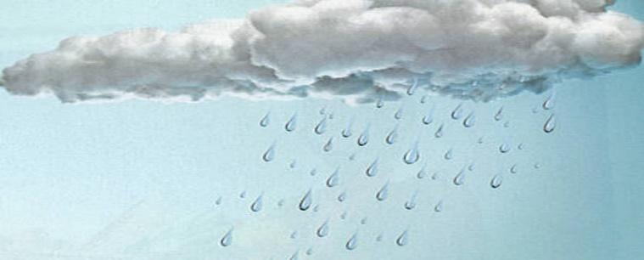
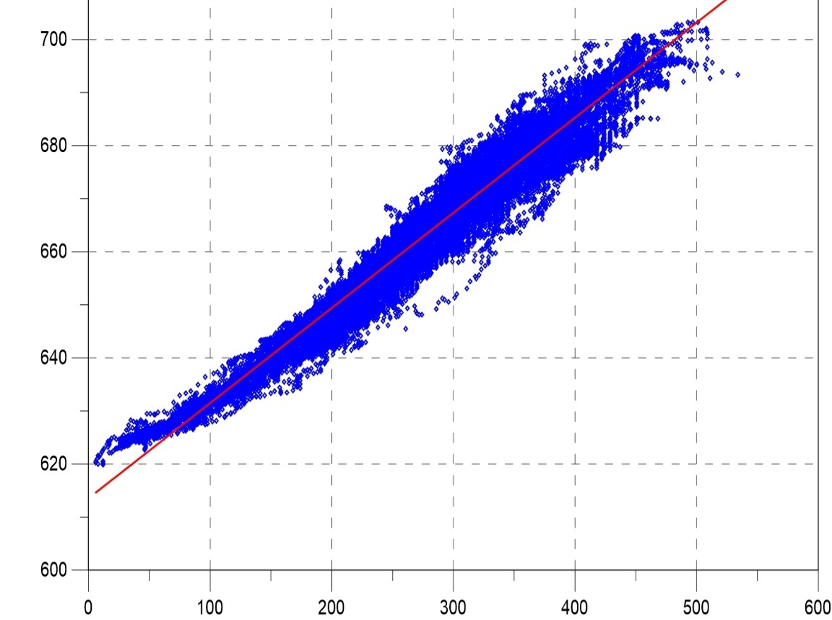
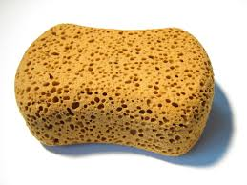
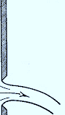
Water Quantity – Aquifer Storage vs. Springflow
Enhancing long-term storage appears to be a viable strategy to increase the Firm Yield of the Aquifer
Comal Spring Discharge vs. J-17 WS Elevation
Full > 700 MSL

10 Yrs
2 Yrs
5 cfs
1 ft
2 M acft
J-17 WS Elevation (ft)
Stage 3 = 640 MSL
0.9 M acft
Comal Springs,
Dry = 612.5 MSL
Comal Spring Discharge (cfs)
Notes:
Before we look at specific strategies, let’s look at the potential benefits of additional long-term storage in the system.
As we know, when the level of groundwater in the Aquifer is high, it creates more hydraulic pressure at the elevation of the spring which increases rates of springflow. In addition, additional springs that are normally dry may also start to flow. A graph of the discharge of Comal Springs vs. the elevation of the J-17 well is shown in the chart on the left. The rate of discharge for Comal Springs increases at a rate of 5 cfs per foot of water level increase. 5 cfs flowing for a year produces a larger volume of water than our 4 recharge dams added together during average years. At the same time, the approximate volumes of storage in the aquifer between “full”, at 700’, versus Stage 3 Restrictions, at 640’, is approximately 2M acft, which Mark showed earlier typically lasts 2 years when we were in drought. We need to extend the two year storage volume of our natural system and extend it closer to 10 years if possible. A way to take advantage of our efficient natural recharge rates is move water into storage during times of high rates of spring flow. So what amount of water Edwards water is available for long term storage?
So if we had additional storage, “what volume of water is available to be stored long-term without enhanced recharge rates?” the next slide approximates an answer to that question.

Slide 45
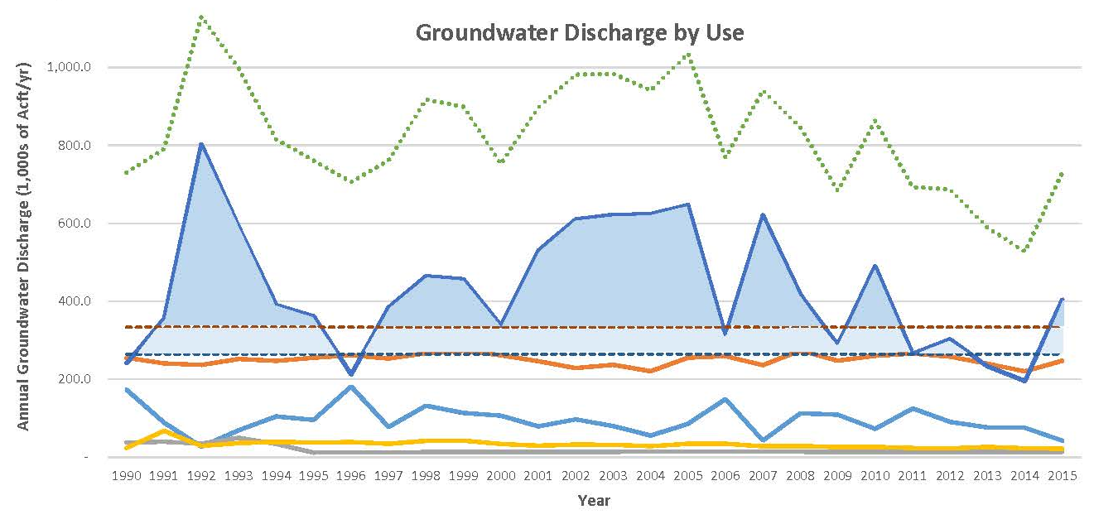
Quantifying “Additional” Supply for Potential Storage
Description | > 460 CFS | > 365 CFS
Annual Mean | 119 | 171
Annual Median | 64 | 133
25 Yr. Accumulated Storage Inflow | 3,105 | 4,454
25 Yr. Peak Storage Capacity | 2,754 | 4,277
Total Discharge
(1,000s of Acft)
Springflow
460 cfs – Hist. Mean Springflow
365 cfs – Min. Long-term Mean Springflow
Municipal
Irrigation
Dom/Stock
Indust/Comm
Notes:
This chart shows the previous 25-years of groundwater discharge by Use from the Aquifer. Springflow is shown in dark blue and municipal use in shown in orange. Irrigation is shown in light blue. The historical mean for springflow is shown in dark red dash and the minimum sustainable long-term average springflow determined by the EAHCP is shown in the blue dash. In this example, I considered the volume of springflow in excess of these averages as a potential source of additional water for long-term system storage somewhere in the system – either from a well or diverting downstream surface water. The table quantifies the volume of springflow in excess of these springflow averages. High spring flows represent peaks that could be “shaved off” and stored for future droughts.
As shown in the table, the resulting volume of supply for additional storage is substantial. Depending on the level of minimum springflow chosen, the annual mean is either 119K or 171K acft/yr. The Annual median is 64k or 133 K acft/yr.
If the long-term storage capacity is large enough, over the past 25 years, the accumulated storage volume could have been 3.1M acft or 4.4M acft depending on the minimum springflow rate chosen. (remember that the storage in the aquifer from full to Comal Springs dry is 2.9M acft). Assuming the system is operated to withdraw from storage when springs are less than average results in peak storage volumes of 2.7M and 4.2M acft. This very approximate estimate shows the potential of long-term storage. 2.5M acft is a 10-year supply for the current municipal demand average.
Municipal mean = 250; median = 253
Irrigation mean = 95: median = 90
Total Wells mean=395: median = 392
Springs mean= 429: median = 397
Long-term minimal average (50-year) at Comal = 225 cfs, San Marcos = 140 cfs.

Slide 46
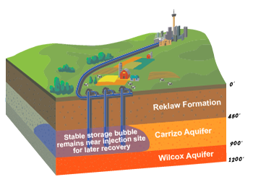
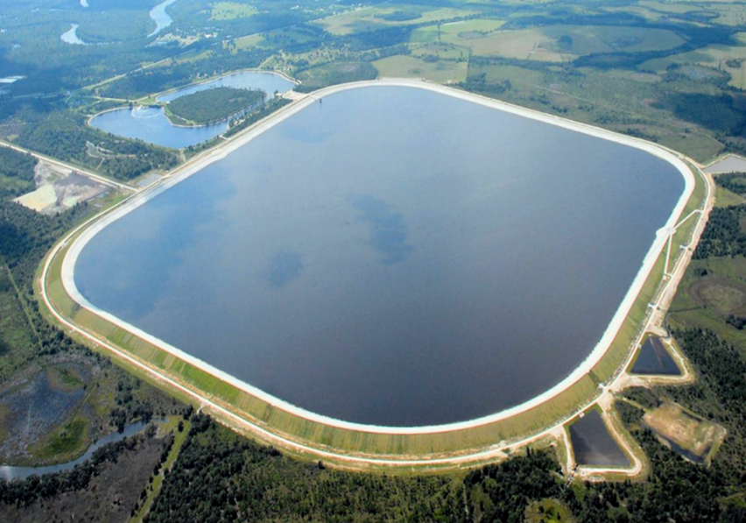
Long-Term Storage – Established Strategies
  Aquifer Storage Recovery (ASR)
    Benefits
      Potential for no treatment requirements
      No evaporative losses
    Concerns
      Quality of the recovered water
      Capture of stored groundwater by others
      Aquifer parameters
  Off-Channel Reservoir (OCR)
    Benefits
      Less environmental impacts than in-channel reservoirs.
      Surface water rights vs. groundwater
    Concerns
      Evaporation and seepage losses
      Cost effectiveness of potable water delivery/treatment system
Notes:
So now let’s look at a few Alternative Storage concepts a discuss their strengths and weaknesses.
ASRs and OCRs are currently functioning long-term storage strategies that increase Firm Yield within our region as an alternative to the complications of instream reservoirs. As demonstrated by the SAWS ASR into the Carrizo, the sand aquifer is working well to hold a bubble of 100K acft of Edwards Water in a relatively static location over the long-term that does not require treatment upon removal. SAWS believes that the capacity of the SAWS ASR to be 120K acft. The NBU ASR is expected to answer questions over the next several years whether the saline Edwards aquifer is a feasible site for ASR projects.
OCRs have less environmental impacts that in-channel reservoirs and have the advantage of appropriate surface water rights over ASRs. Evaporation favors ASRs although floating covers can greatly reduce evaporation losses in reservoirs. OCRs can be designed to accept large rates of flow if trying to scalp flood flows from a river. Water would require treatment for potable use.

Slide 47
2016 Region L Plan - ASR and OCR Storage Projects
ASRs (9% of future water supply)
  GBRA Mid-Basin ASR - 50,000 acft/yr @ $1,637/acft/yr
  Victoria ASR - 7,900 acft/yr @ $ 192/acft/yr
  NBU ASR - 8,300 acft/yr @ $ 462/acft/yr
  Uvalde ASR - 1,155 acft/yr @ $2,803/acft/yr
                67,355 acft/yr
OCRs (16% of future water supply)
  GBRA Lower Basin Storage – 51,800 acft/yr @ $ 140/acft/yr
  GBRA New Appropriation (Lower Basin) – 42,000 acft/yr @ $ 591/acft/yr
  93,800 acft/yr
  LCRA Lane City Reservoir Project (Region K) – 90,000 acft/yr @ $ 223/acft/yr
Notes:
Here are the ASR and OCR projects listed in the 2016 Region L State Water Plan. These strategies comprise 25% of the additional water resources for the region over the next 50 years.
ASRs - The GBRA Mid-Basin ASR is proposed to firm up interruptible diversions from the Guadalupe River by using the Carrizo Aquifer.
OCRs - The GBRA New Appropriation project is located in Calhoun county and will use existing gravity flow diversion facilities just upstream of the salt water barrier to fill up to a 200,000 acft impoundment reservoir.
The GBRA Lower Basin project will allow the GBRA and Dow Chemical company to divert and store already owned water rights in a relatively small 12,500 acft reservoir which will be filled and drained multiple times during the year to improve efficiency in management of water supply. The GBRA is in the preliminary design phase and is currently collecting environmental data on several potential project sites for both projects.
The LCRA Lane City reservoir project, on the Colorado River in Region K, is planned to be operational in late 2018. The project allows the LCRA to more efficiently supply agriculture irrigation by increasing the storage capacity of their overall lake system. 40K acft reservoir, 40’ D x 1mi x 2mi.

Slide 48
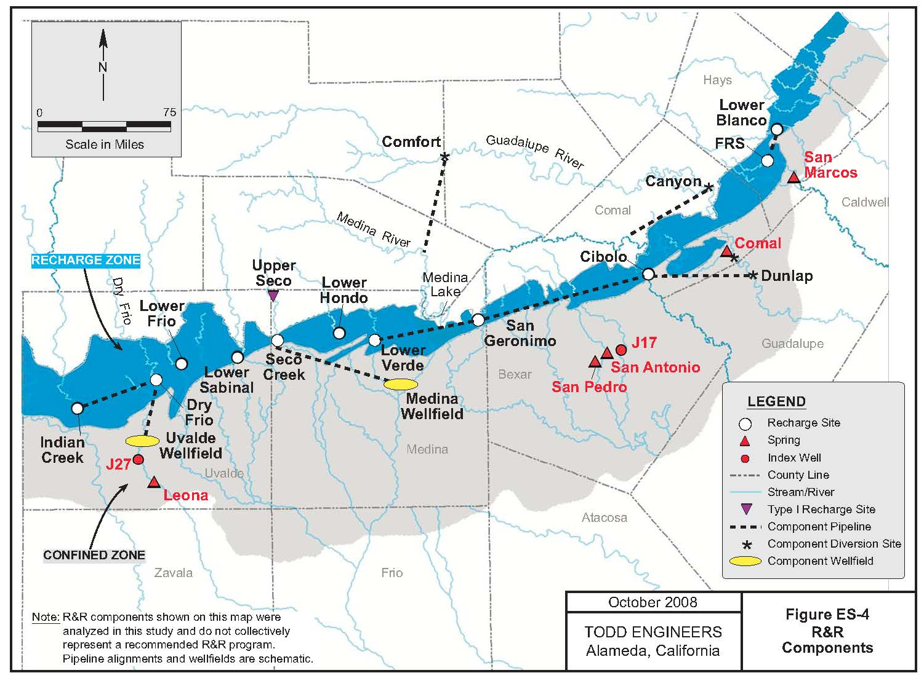
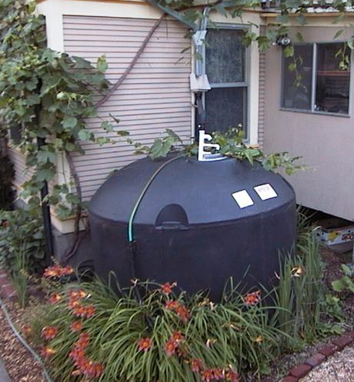
Long-Term Storage – Conceptual Strategies
  Aquifer Recharge and Recirculation
    Benefits
      No cost for additional storage reservoirs
      No treatment anticipated.
    Concerns
      Uncertainty in modeling.
      Aquifer residence time.
      Complex management and authorization issues.
  Rainwater Harvesting
    Benefits
      Reduces water consumption of individual properties during normal weather patterns.
    Concerns
      Application to watershed scale is problematic:
        private property rights,
        voluntary participation,
        limited storage,
        reliable operation and maintenance.
Notes:
These two storage strategies are considered conceptual strategies because contributions to Firm Yield have not been established. R&R is primarily a storage strategy, with the twist of using the Edwards aquifer as the storage basin. The Todd Study in 2008 evaluated a system of diversions and recharge locations with several management strategies but the ability to predict how the system will function in a karst aquifer is very difficult. Our existing aquifer model is not designed to simulate the transport of water in the system, which the R&R strategy requires. Other concerns are that the residence time in the aquifer is too short for Firm Yield criteria.
Rainwater harvesting is currently a storage strategy for individual properties to reduce water consumption during normal weather patterns. It is not considered a basin wide strategy that adds to the Firm Yield of the aquifer. Planning is problematic for the reasons listed, which provide uncertainty to the benefits of this strategy on a watershed scale.

Slide 49
Optimizing Beneficial Use - Management
Water Quality
Aquifer Groundwater
  Well canvassing program
  Abandoned Well Plugging Initiative
Aquifer Recharge Water
  Regulated material storage/handling
  Conservation Easements (COSA EAPP)
  Urban BMPs (TCEQ WPAP)
  Agriculture BMPs (EA SRC)
  First Responder Training
Aquifer Research
  Vulnerability Study (EAA)
  Urban BMP Effectiveness Studies (COSA Proposition 1 funding)
Water Quantity
Recharge
  Un-captured surface water leaving the EARZ
  Precipitation Enhancement*
  Protect natural recharge rates
Storage
  Aquifer Storage Recovery (ASRs)
  Off-Channel Reservoirs
  Recirculation and Recharge*
  Rainwater Harvesting*
Management
  EAHCP
  Edwards Transfers
Other
  Edwards Desalination
  Water Reuse
  * Requires further analysis to determine if practice contributes to firm yield
Notes:
The EAA has developed efficiency in Aquifer management strategies made possible by the EAA Act to limit pumping. As mentioned earlier, these two strategies add over 62,000 acft/yr to the Firm Yield of the Aquifer at a cost of $550/acft/yr.

Slide 50
Optimizing Beneficial Use - Other
Water Quality
Aquifer Groundwater
  Well canvassing program
  Abandoned Well Plugging Initiative
Aquifer Recharge Water
  Regulated material storage/handling
  Conservation Easements (COSA EAPP)
  Urban BMPs (TCEQ WPAP)
  Agriculture BMPs (EA SRC)
  First Responder Training
Aquifer Research
  Vulnerability Study (EAA)
  Urban BMP Effectiveness Studies (COSA Proposition 1 funding)
Water Quantity
Recharge
  Un-captured surface water leaving the EARZ
  Precipitation Enhancement*
  Protect natural recharge rates
Storage
  Aquifer Storage Recovery (ASRs)
  Off-Channel Reservoirs
  Recirculation and Recharge*
  Rainwater Harvesting*
Management
  EAHCP
  Edwards Transfers
Other
  Edwards Desalination
  Water Reuse
  * Requires further analysis to determine if practice contributes to firm yield
Notes:
And finally, I want to mention 2 additional strategies that do not directly draw from the freshwater zone of the Aquifer but could have significant water planning impacts in the future.

Slide 51
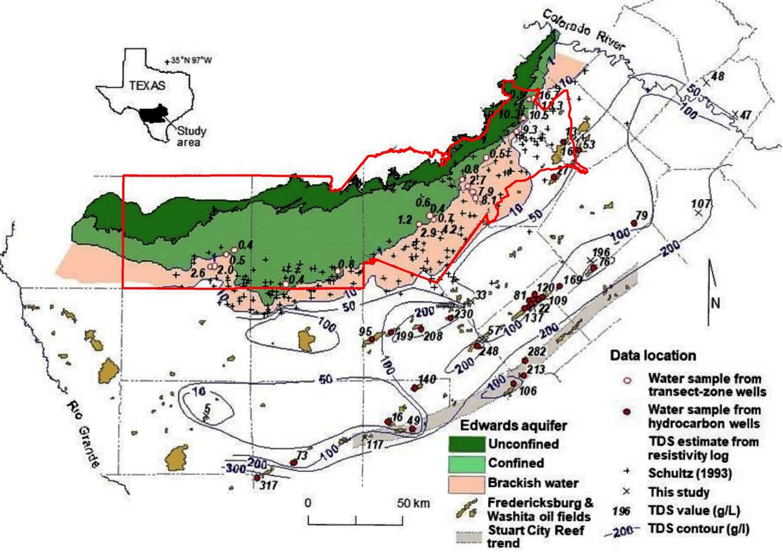
Other - Edwards Desalination
Benefits
Plentiful supply.
Unaffected by drought conditions.
Concerns
Requires Edwards permit within EAA jurisdiction.
Cost effectiveness of system
Long-term “mining” impacts, or,
Potential drawdown of EA freshwater zone.
Graphic provided by:
Dr. Alan Dutton and Stephen Hoff
Notes:
Much like the SAWS Desal project in the Wilcox Aquifer, the Edwards desal Tan colors of the above map are considered the brackish zone of the Edwards with TDS between 500 and 10,000 ppm. The areas within our jurisdiction, shown in the red line, are treated the same as freshwater and require a permit. The areas outside of our jurisdiction are not regulated. This graphic was provided by Dr. Alan Dutton and his graduate student Stephen Hoff from a paper that is currently in peer review. A potential benefit is the large volume of water available to contribute to firm yield when called upon.
Concerns are the Edwards permit requirement within EAA jurisdiction and the unknown aquifer permeability and transmissivity. Depending on the amount of flow connection to the freshwater zone, this may be an isolated mining operation or just an expansion of demand on the freshwater pool. Edwards saline represents a large volume of water with some significant unknowns.

Slide 52
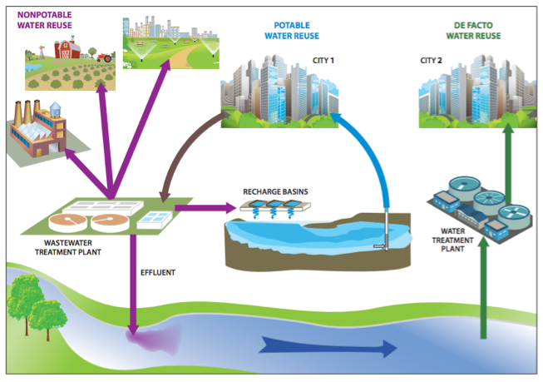
Other - Water Reuse: Categories of Use
Non-Potable Reuse
  Irrigation
  Industrial processes
Indirect Potable Reuse (IPR)
  Discharge of advance treated effluent into a natural water source for further treatment before drinking.
Direct Potable Reuse (DPR)
  Direct connection of advance treated effluent into a municipal water supply system.
De Facto Reuse
  Discharge of conventionally treated effluent into water bodies that serve as source water resources for downstream communities.
DPR
IPR
Notes:
Water reuse has several subcategories. Typical non-potable uses are irrigation and industrial processes. SAWS has demands for non-potable reuse beyond what they can currently provide primarily because it is not subject to drought restrictions. So, non-potable water reuse is in demand and will continue to be a large component of Edwards demand reduction in the future.
The other three subcategories are for potable reuse including IPR, DPR, and de Facto reuse. [define] Advanced treatment technologies currently exist and are currently implemented in Texas at reasonable prices to purify effluent water for both direct and indirect potable use. Advanced treatment could solve two problems at once, reduce current pollutant loadings and provide a valuable water supply source.

Slide 53
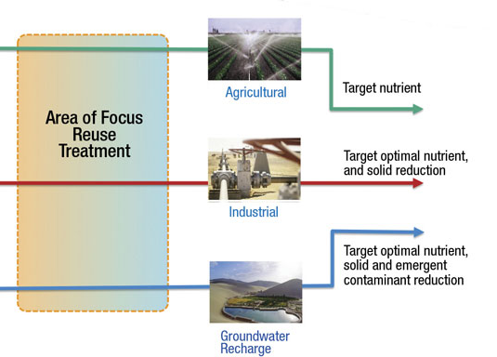
Other - Water Reuse
Benefits
  Reduce pollutant loadings.
  Reliability during drought.
  Supply increases with population.
Concerns
  Safeguards to protect human health.
  Public perception.
  Disposal of concentrate from water purification process.
Notes:
The technology is there and direct potable reuse is being operated successfully in Big Spring and Wichita Falls.
It has sustainable benefits of reducing pollutant loading while providing a reliable source of water in times of drought that increase in supply as the population increases.
Concerns are safeguards in the system to protect human health (including contaminants of emerging concern), overcoming the public “yuck factor” and disposal of concentrate from the water purification process.
This concludes a review of optimization strategies.

Slide 54
Staff Recommendations
  Re-Conceptualizing the EAA’s Program Vision
  Recommended Program Initiatives
Notes:
As we enter the last portion of the presentation and focus on where the program goes from here, I think it is important to update the status of Region L water planning before we talk about the EAA program vision.

Slide 55
Re-Conceptualizing the “Recharge” Program Vision:
Optimizing and Protecting the Beneficial Use of the Aquifer
Manage
Manage
Optimize Quantity
Enhance
Protect Quality
Protect

Slide 56
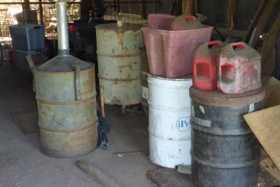
2. Protect Water Quality
Recommended Program Objectives
1. Optimize Water Quantity
  Protecting natural recharge and increasing long-term system storage are recommended priorities to optimize the Firm Yield of the Aquifer.
    The Edwards Aquifer Protection Program.
    Facilitate annual workshop for innovative optimization and protection strategies.
    Function as a liaison to water supply projects sponsored by others.
    Facilitate regional collaboration.
Protecting recharge water quality is essential for long-term sustainability of the Aquifer.
  Identify and prioritize risks to water quality.
  The Edwards Aquifer Protection Program.
  Provide input(s) to facilitate more effective policy and regulation by others.

Slide 57
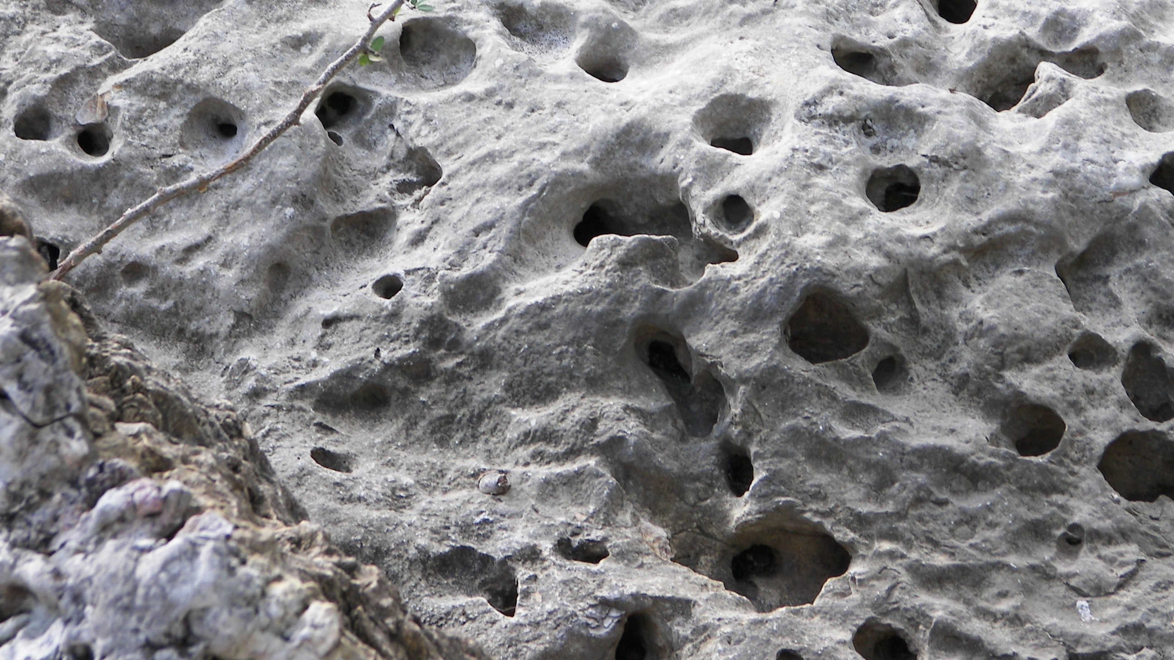
Questions?
.

