Slide 1


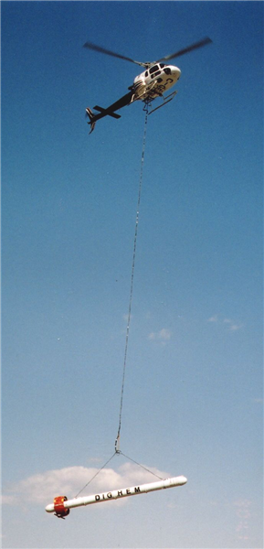
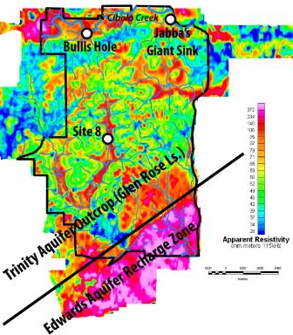
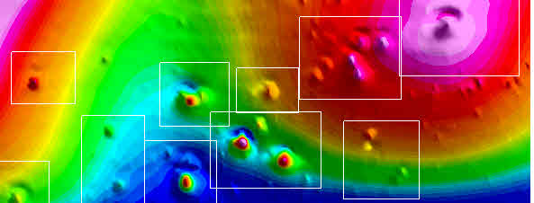
Marcus Gary
David V. Smith
Re-evaluation of airborne GEOPHYSICAL SURVEYS IN THE Edwards and Trinity Aquifers:
A collaborative project with the EAA and USGS
EAA Board of Directors – Technical Briefing
April 11, 2017

Slide 2




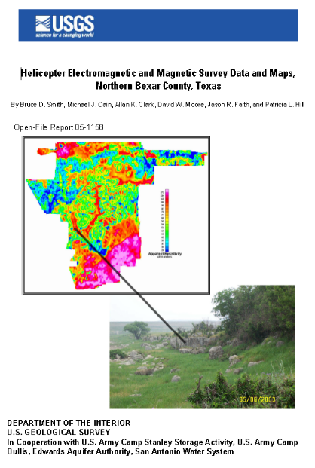
Data Acquisition and initial data reporting
2002
2003
2005

Slide 3
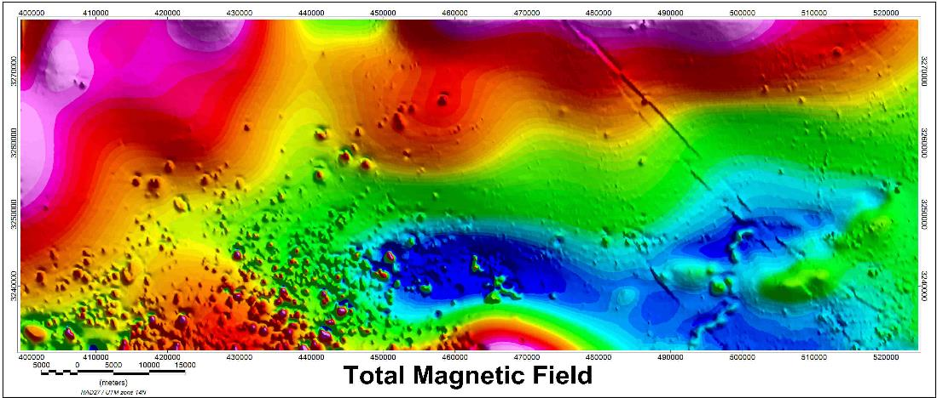
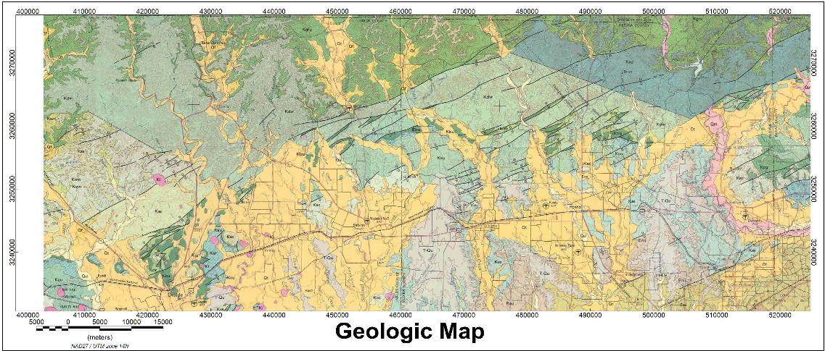
Survey area in Medina and Uvalde counties

Slide 4
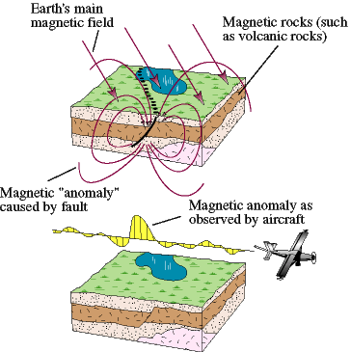
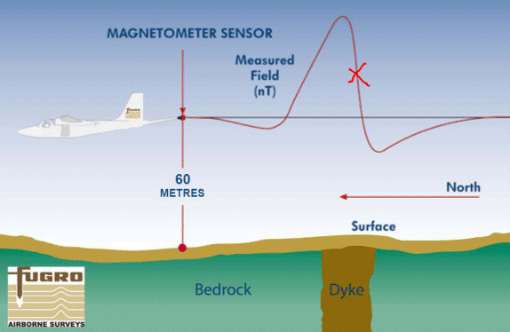
High Resolution Aeromag Survey
Passive sensing of magnetic anomalies on surface and in subsurface

Slide 5
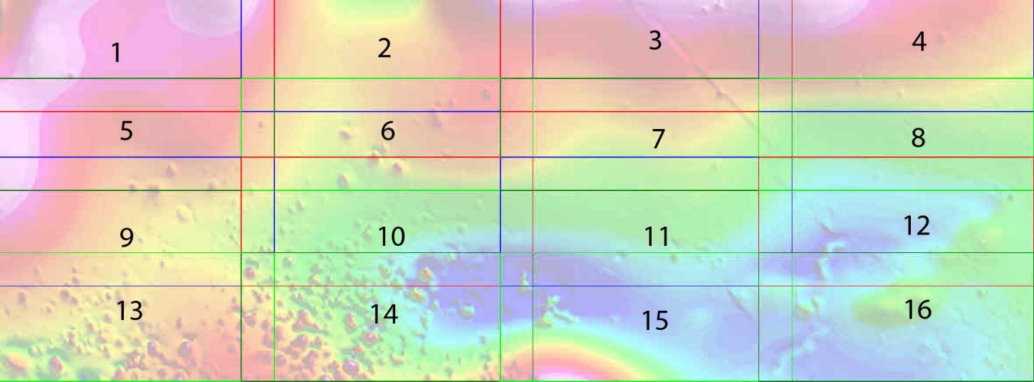
Mag survey subdivided into manageable blocks
The entire survey was subdivided into smaller blocks for inversion modeling.

Slide 6
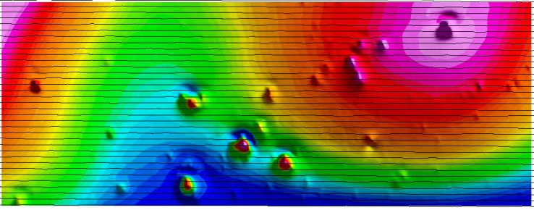
Test analysis in block 6
Ten study areas were extracted for inversion modeling.
Very small anomalies were not covered by sufficient flightlines (shown in black) for inversion modeling.

Slide 7
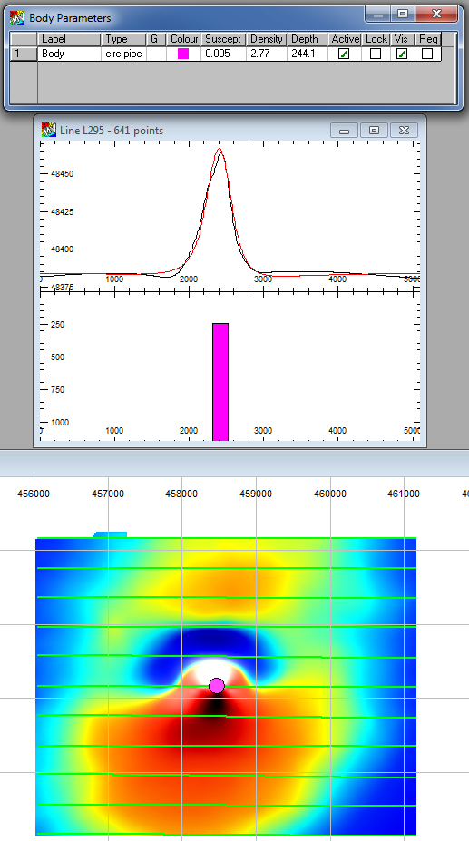
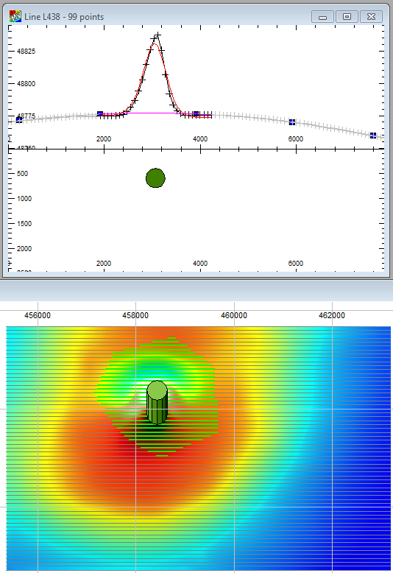
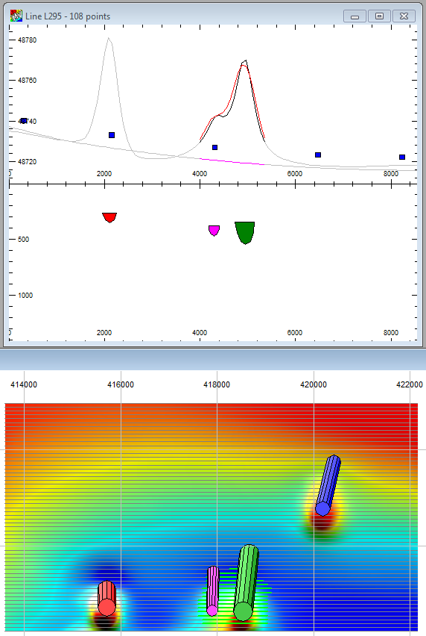
Preliminary EarthVision Modeling
Dimensions and locations of model bodies (vertical pipes in these cases) are automatically adjusted until the modeled anomaly (red line) closely matches the airborne data (black line).
Multiple anomalies
Single anomaly with
Body Parameters shown at top
Single anomaly

Slide 8
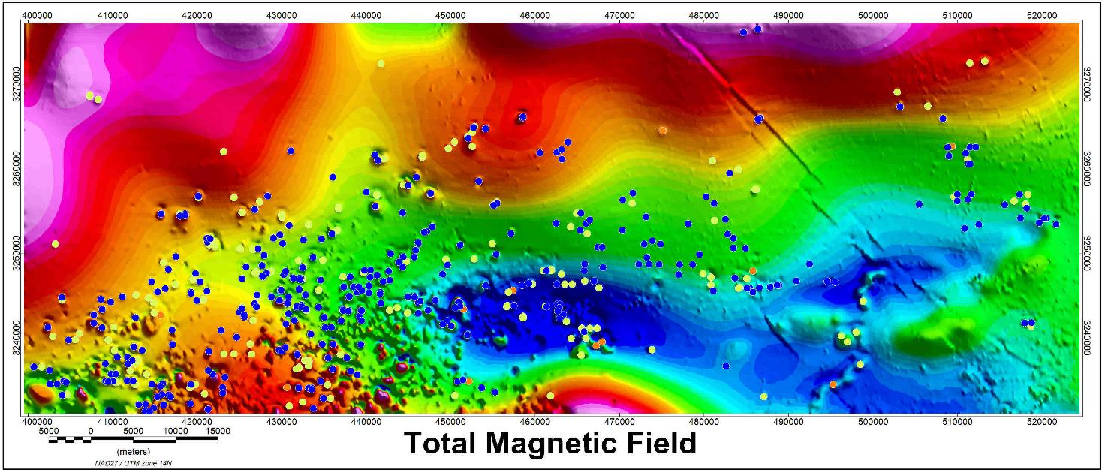
The inversion results for the 16 blocks, with depth to top of bodies depicted with dot symbols
Dot Symbols
Blue = shallow
Yellow = medium
Orange = deep

Slide 9
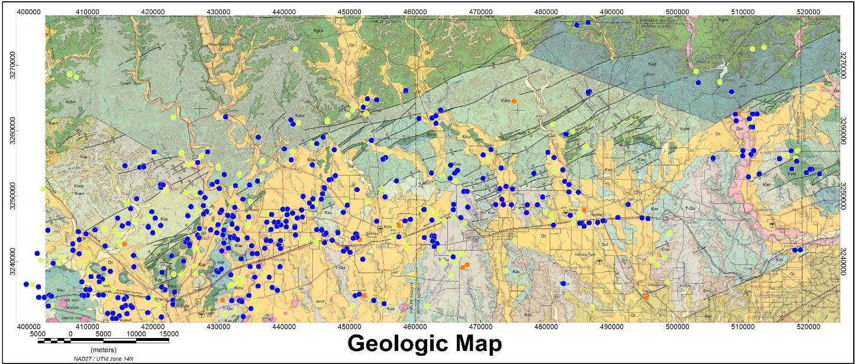
Surface geologic map with depth symbols
Dot Symbols
Blue = shallow
Yellow = medium
Orange = deep

Slide 10
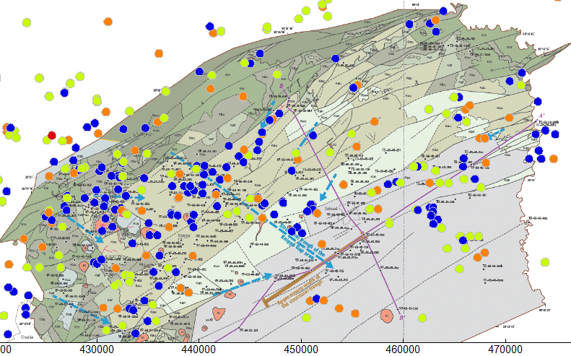
Geologic map with depths to anomalies
Dot Symbols
Blue = shallow
Yellow = medium
Orange = deep
USGS Knippa Gap Report
SIR2013-5149

Slide 11
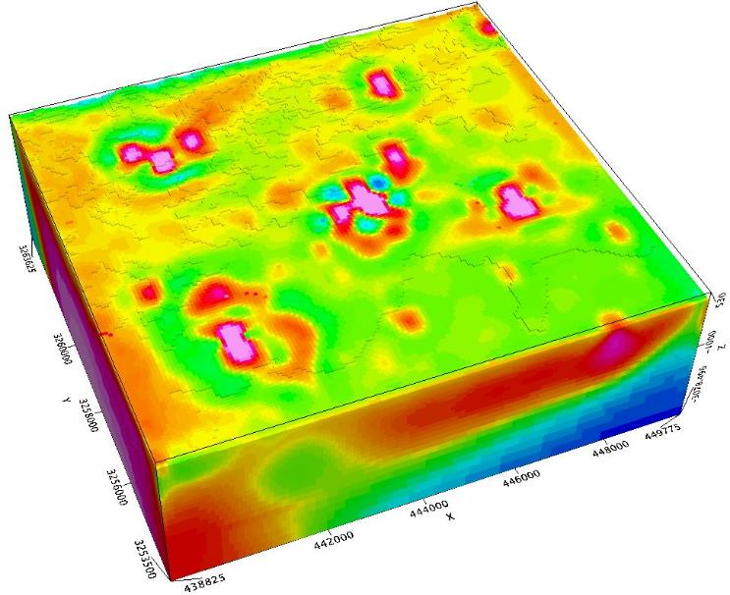
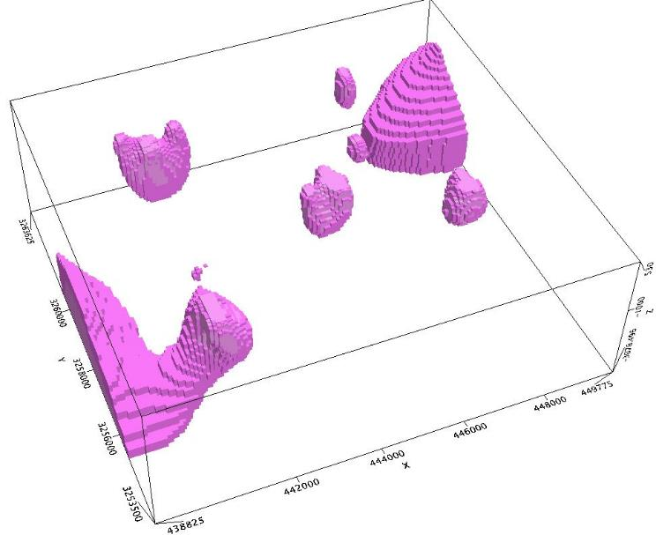

Multiple Anomalies
These anomalies appear to be isolated bodies, but notice how a deeper body feeds the shallow anomaly in the southwest.

Slide 12
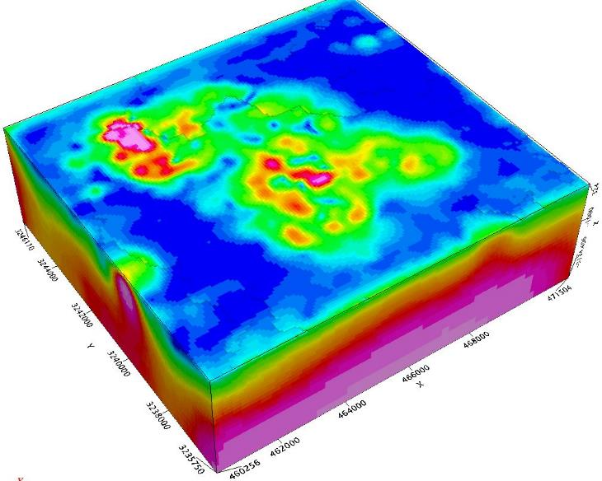
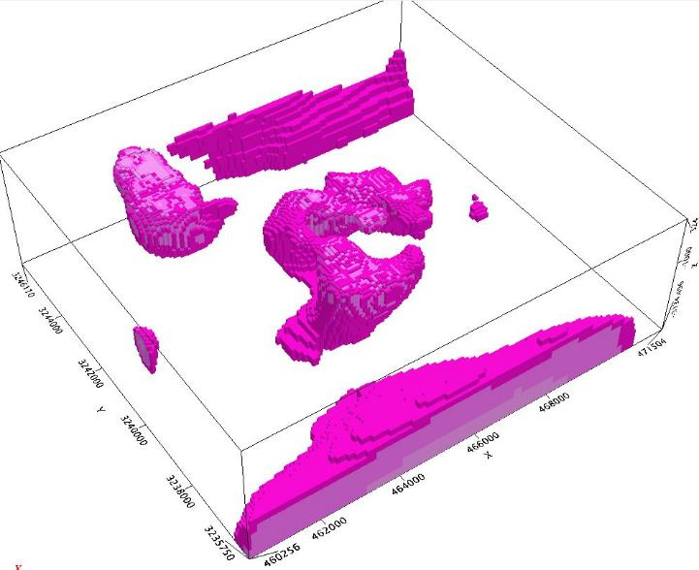
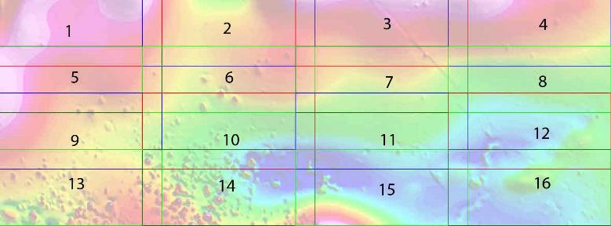
Sabinal Anomaly
This cluster of anomalies appear to be connected to a deeper source.

Slide 13
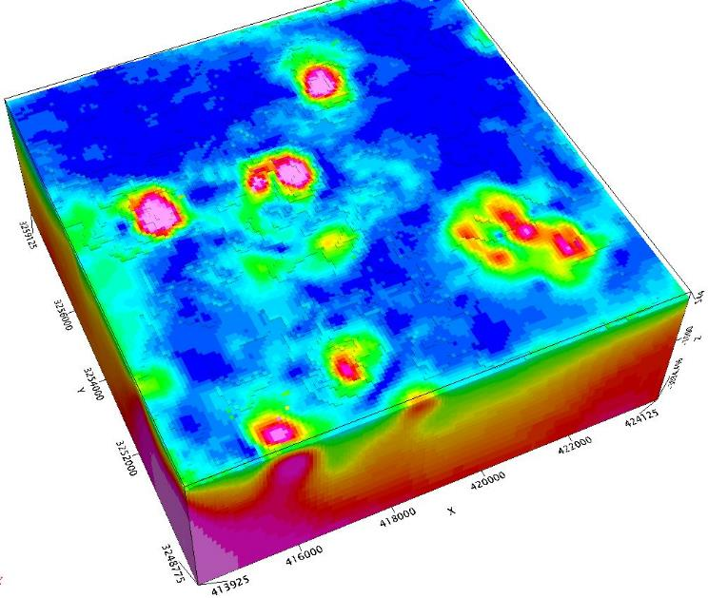
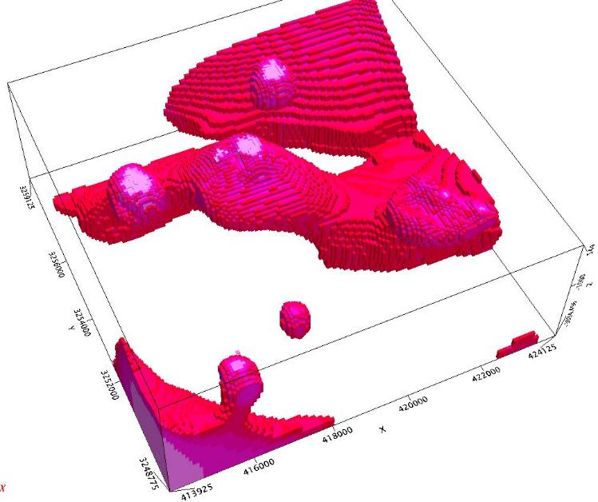
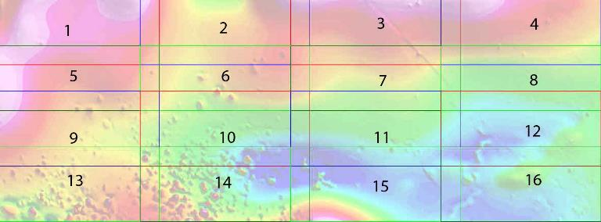
Deep Creek Anomalies
Although appearing isolated, these anomalies are connected to the same parent body.

Slide 14
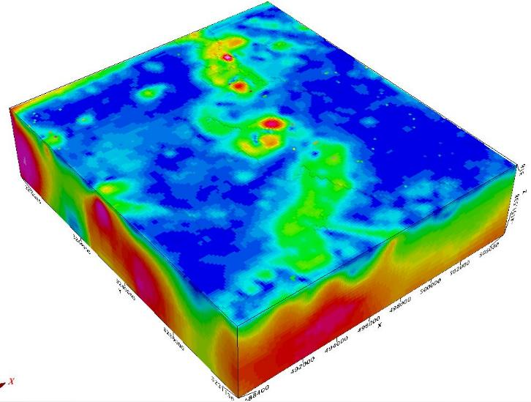
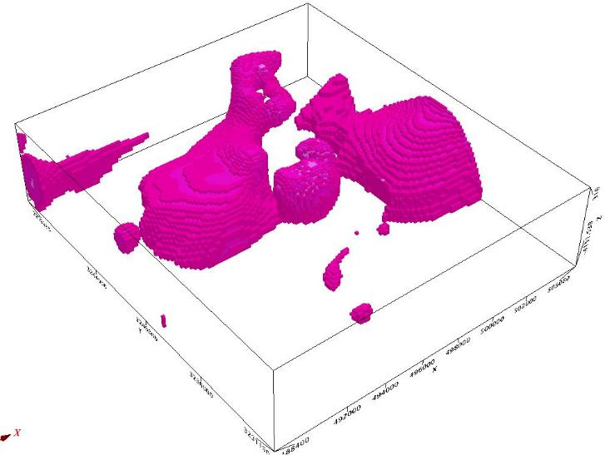

Castroville Anomalies
Notice how deeper bodies appear to feed the shallow meandering feature.

Slide 15
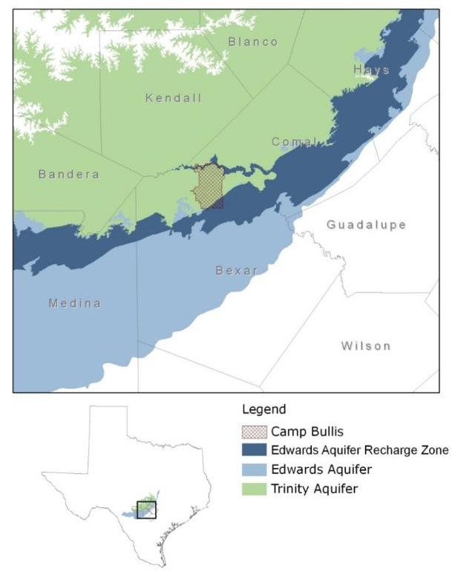
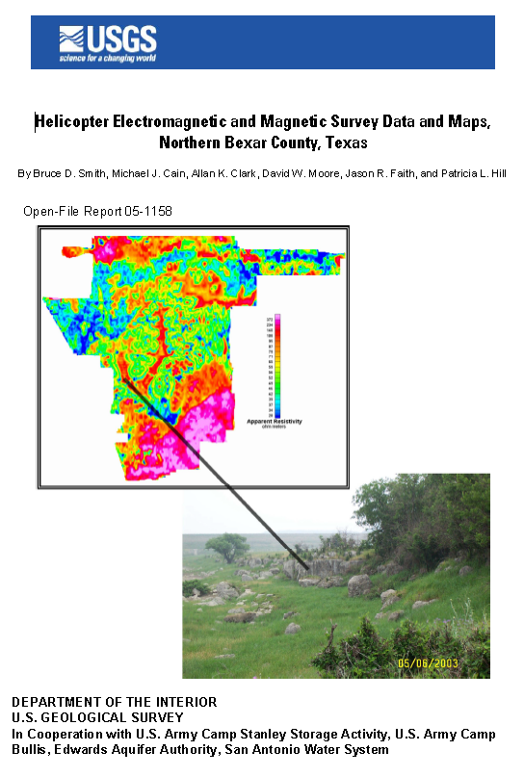
Camp Bullis AEM Study

Slide 16
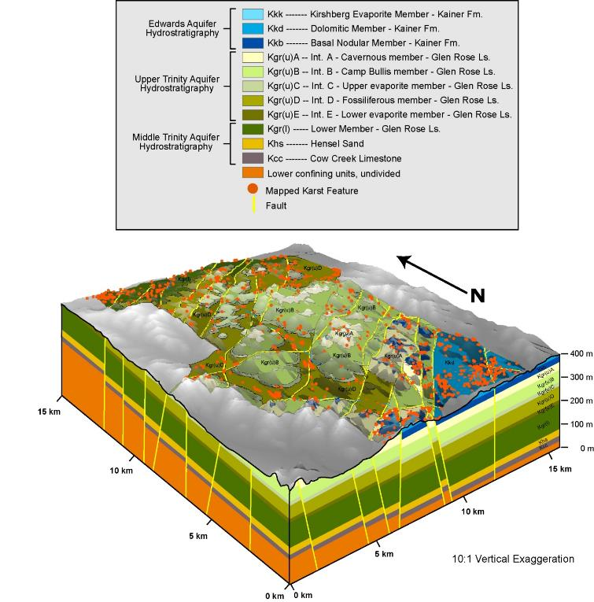
KARST FEATURE MAPPING
Karst feature mapping at Camp Bullis identified >1,200 features.
Recharge sensitivity ranked low, medium, and high based on numerous geologic and hydrologic factors.
Karst feature density is calculated for each mapped geologic unit (Edwards outcrops highest).
LITH. UNIT | All karst features (#) | High (#) | Medium (#) | Low (#) | Area (km²) | Karst Feature Density (features/ km²)
Kkk | 10 | 0 | 5 | 5 | 0.159 | 62.78
Kkd | 279 | 33 | 88 | 158 | 8.688 | 32.11
Kkb | 68 | 6 | 24 | 38 | 3.523 | 19.30
Kgr(u)A | 75 | 1 | 15 | 59 | 12.354 | 6.07
Kgr(u)B | 78 | 4 | 9 | 65 | 34.662 | 2.25
Kgr(u)C | 16 | 2 | 3 | 11 | 5.580 | 2.87
Kgr(u)D | 268 | 51 | 104 | 113 | 33.311 | 8.05
Kgr(u)E | 2 | 0 | 0 | 2 | 1.328 | 1.51
Kgr(l) | 168 | 38 | 75 | 55 | 13.907 | 12.08
TOTAL | 964 | 135 | 323 | 506 | 113.511 | 16.33

Slide 17
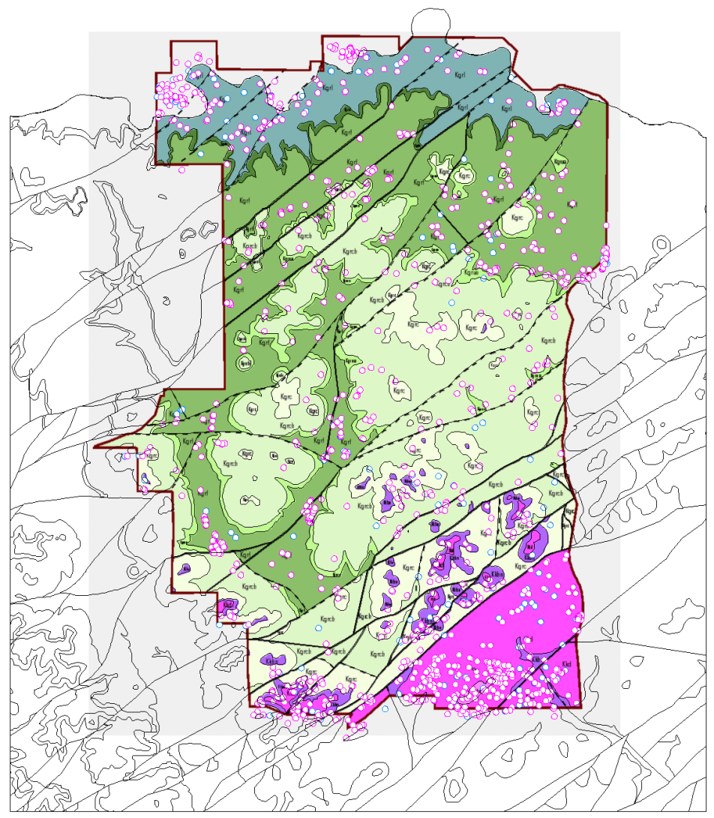
Camp Bullis Karst Database
Geologic Map
Karst feature
Cave

Slide 18

Cibolo Creek DIRECT CURRENT RESISTIVITY Surveys
Cibolo Creek is ephemeral, and rapidly recharges the aquifers during storms and wet periods.
Surveys were conducted at injection points for tracer studies (Jabba’s)

Slide 19
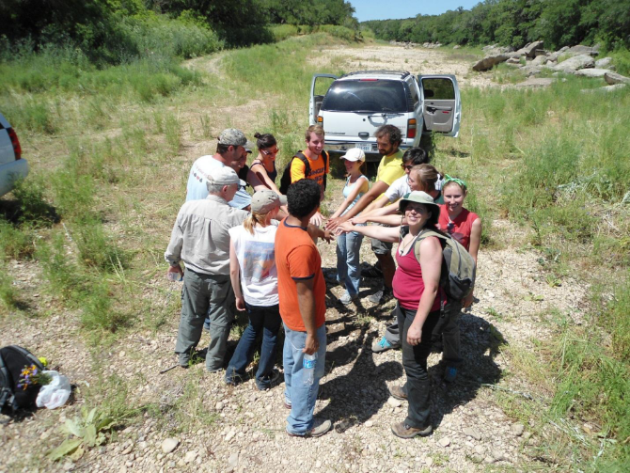
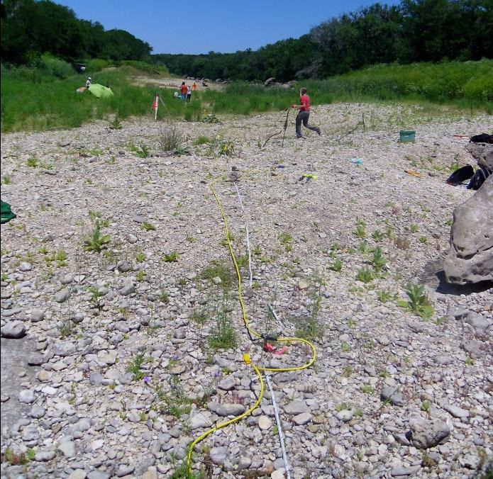
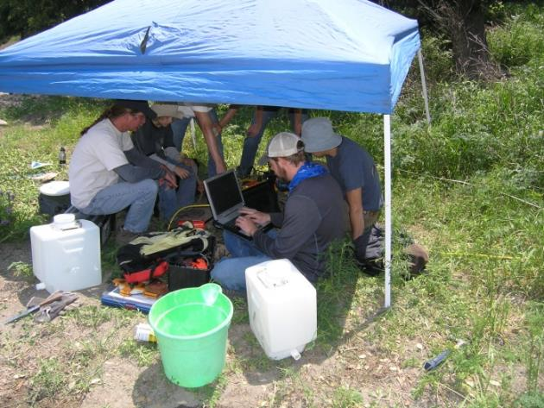
Suevey of two major karst recharge features
Help from UT Karst Class

Slide 20
BULLIS HOLE CAVE MAP

Slide 21
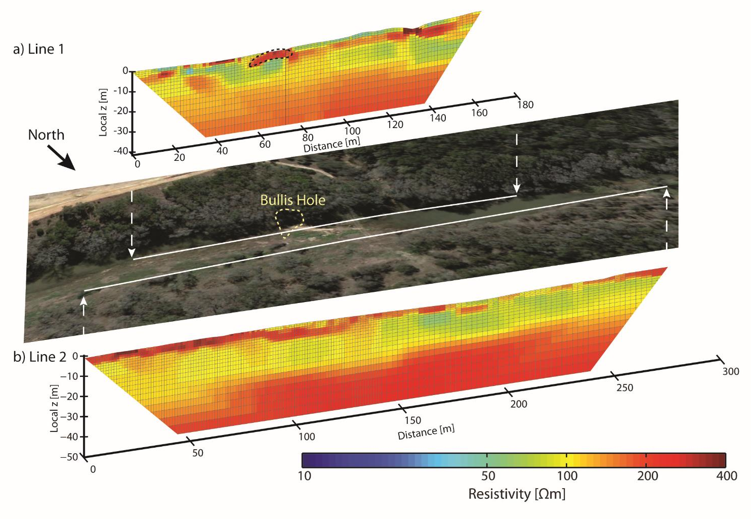

Slide 22
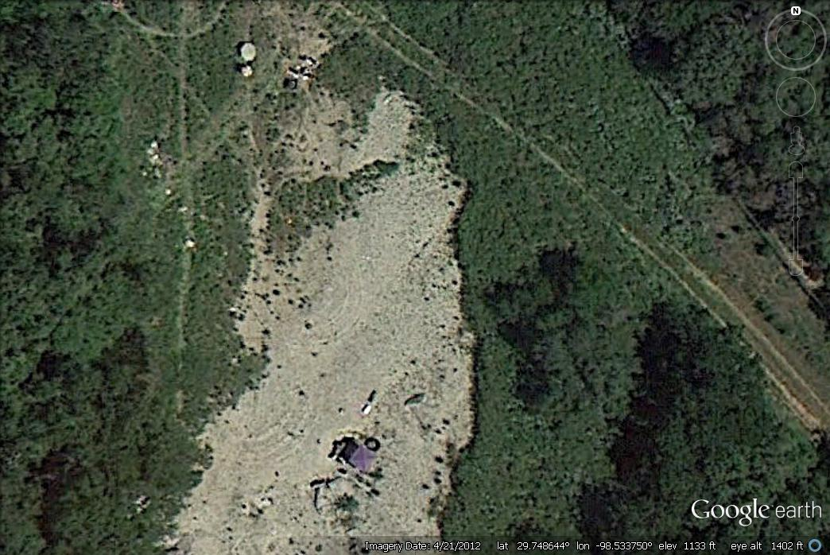
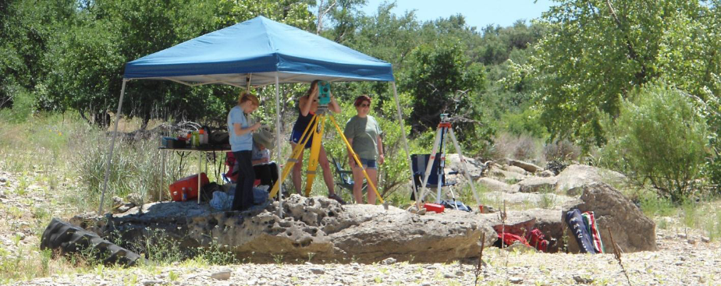

Slide 23
JABBA’S GIANT SINK CAVE MAP

Slide 24
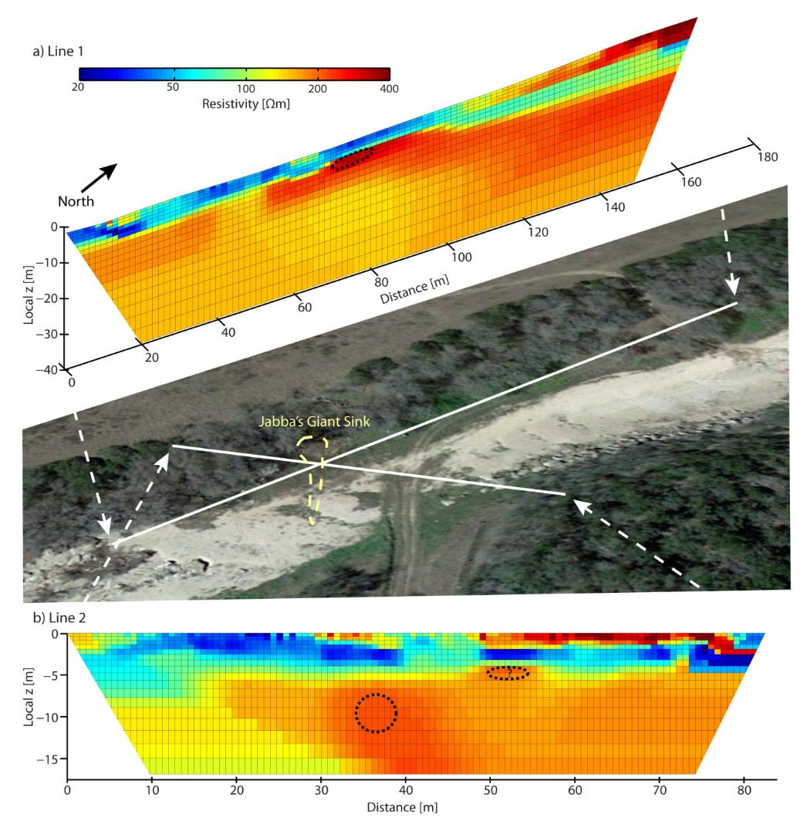

Slide 25
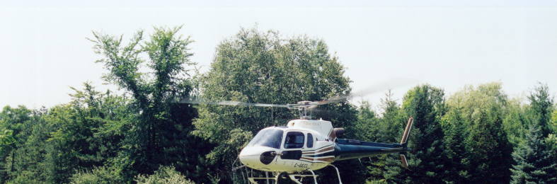
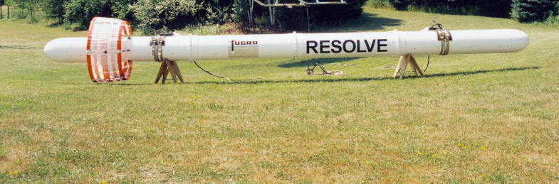
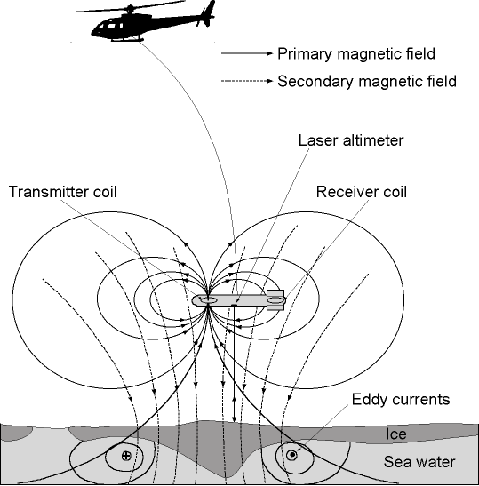
Camp Bullis AEM Study

Slide 26
Airborne Electromagnetic Geophysics
3. Completion of flight survey (data collection) – contractor deliverables
1. Conceptual model- Flight and survey planning
2. Ground based characterization – refine survey plan
4. Resistivity depth cross sections - Interpretation of collected data
5. Three-dimensional representation for hydrogeologic framework

Slide 27
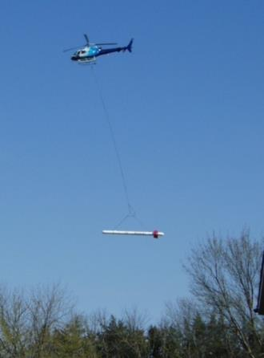
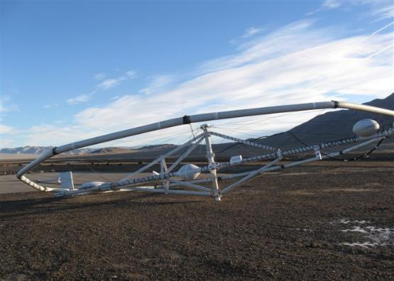
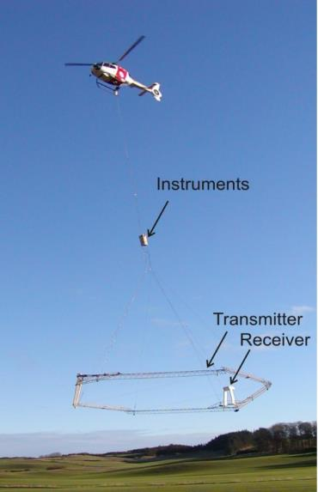
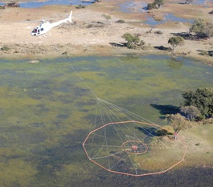
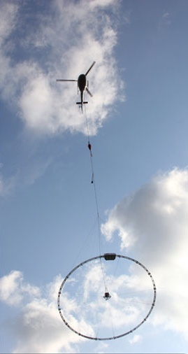

Contemporary AEM systems
AeroTEM
SkyTEM
12 m
RESOLVE
HeliTEM
VTEM
GeoTEM

Slide 28
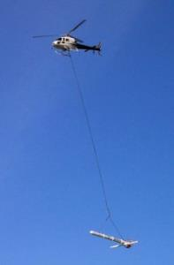
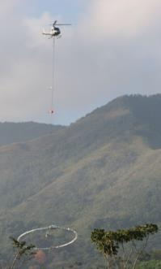
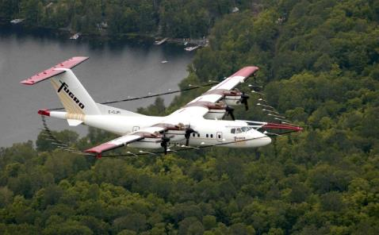


AEM Systems: Relative Footprints and Depths
RESOLVE
Frequency domain
TEMPEST
SkyTEM
Time domain
Small
Target
MEGATEM
100m
Depth of investigation depends on earth conductivity and target size.
Hectares/hr:
810 720 3200 6500
Notes:
The system “footprints” shown here are approximations of the volume of earth that an AEM system samples as it flies. The volume of ground sampled by a fixed-wing time domain system is much larger, and the depth of exploration much greater. However, if the target is small like the red dot, then the volume of the footprint filled by the target is proportionately much greater for the HEM system, so the response of the target relative to the background will be greater. The smaller footprint also provides for higher resolution.
HEM systems are best for near-surface, smaller objects and high resolution. The FW-TDEM systems are better for great depth of penetration.

Slide 29
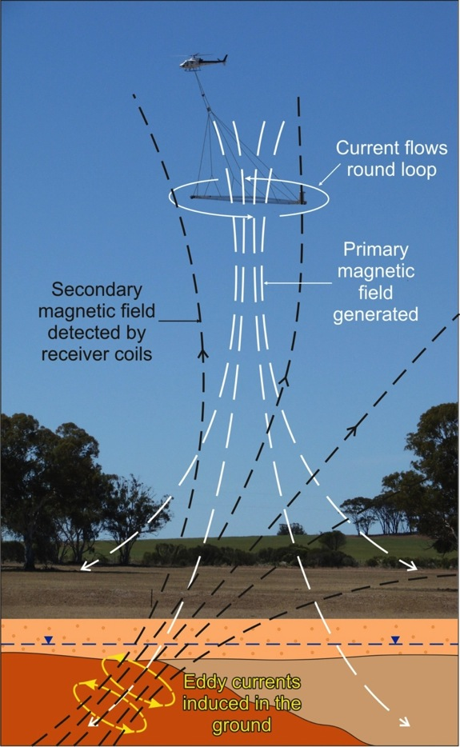
AEM Principles
Transmitter creates time-varying magnetic field (white lines).
The primary magnetic field permeates the earth.
The changing magnetic field induces eddy currents in electrically conductive earth and discrete bodies.
The eddy currents generate secondary magnetic fields (black lines).
The secondary magnetic fields are detected and recorded by a receiver coil.
Signal strength is a function of transmitter power, coil sizes, height of the system above ground, and the electrical conductivity structure of the earth.

Slide 30
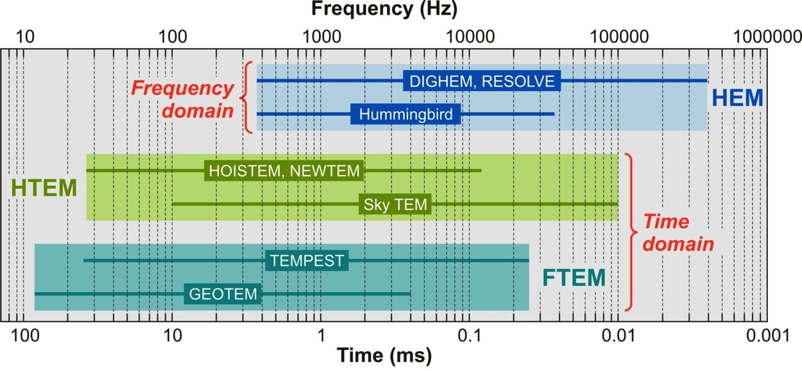

Depth Sensitivity of AEM Systems
RESOLVE system
Deep
~500 m
Shallow
~1-5 m

Slide 31



Final product
2D & 3D
visualizations
(Resistivity
per X, Y, Z)
(Raw data)
(Processed data)
Notes:
This shows the progression from flying the HEM data (a), to recording the frequency dependent responses of inphase and quadrature at each point approximately every 3 meters (b) to numerical 1-D inversions of conductivity with depth (c) to constructing a color coded 3-D block of conductivity with depth for the entire flight area (Adapted from Fitterman, D. V. and M. Deszcz-Pan (1999), Geophysical Mapping of Saltwater Intrusion in Everglades National Park: Proceedings of the 3rd International Symposium on Ecohydraulics CDROM.
31

Slide 32

Interpreting Resistivity Values
Porosity
high
low
Lithology
Resistivity
?
?
Grain
sorting
?
?
?
?
Saturation
Permafrost
Salinity

Slide 33

Status of Project
All 1145 karst features in EAA database have been annotated on individual resistivity-depth sections.
Analyze clusters of karst features with respect to mapped geology and faults.
Correlate karst occurrence with resistivity zones and variations.

Slide 34

Camp Bullis Karst Feature Database
Gridded Map

Slide 35


Karst Features within 50 m of Flightlines
Databases also compiled for 10 m and 20 m distances.
Mapped karst feature
Close-up
No karst mapping done south of Camp Bullis

Slide 36

Apparent resistivity at 115 kHz
This, the highest of the 6 HEM frequencies, senses shallow variations in earth electrical resistivity.
Mapped geologic features (contacts, faults) are shown as black lines

Slide 37

Resistivity-depth Inversions
Both classical smooth multi-layer inversion (using EM1DFM) and novel Markov-chain Monte-Carlo (MCMC) probabilistic methods were employed to compute resistivity-depth profiles
EM1DFM
Line 10620
MCMC
EM1DFM
Line 10640
MCMC
Line 10640 path over geology

Slide 38


Inverted Resistivity at Depth Below Ground Surface
10 m BGS
40 m BGS

Slide 39


Inverted Resistivity at Fixed Elevation
Above Mean Sea Level
Resistivity slice at 340 m AMSL
Resistivity slice at 340 m AMSL

Slide 40

Curtain Diagram of Inverted Profiles

Slide 41

Working within Geosoft
20-m wide box at each feature,
labeled with ID and Distance
Close-up of map window
Window for selecting maps
Window for map viewing
Single resistivity-depth profile
Database of resistivity-depth
profiles
This database is of karst features within 50 m of flightline. Note ‘ID’ and distance ‘Dist’ are tabulated.

Slide 42


Resistivity-Depth Sections
(left justified)
Lines 10010 - 10220
Lines 10230 - 10400
Lines 30010 - 30190

Slide 43


Resistivity-Depth Sections
(left justified)
Lines 10410 - 10540
Lines 10550 - 10740
Lines 30200 - 30350
Lines 30360 - 30380

Slide 44

Correlating Resistivity Zones with Karst Features
Possible karst features present in blue (low resistivity) zone?
Numerous karst features mapped in blue (low resistivity) zone

Slide 45

EARLY ESTIMATES OF
UPLAND RECHARGE VALUES
Based on a “typical” 2.7 cm rain event.

Slide 46













AEM ANALYSIS WILL BE INTEGREATED INTO DIFFUSE RECHARGE STUDY
POINT:
In situ data (23 stations)
H1D Model
FIELD/PLOT:
Eddy Covariance (3)
Shallow Geophysics
Drip rates
Stream/GW
CAMP BULLIS:
ET MODIS (1km)
ET/LAI Landsat (30m)
Well 10
Q_{in}
Water Tank
ΔS
ΔS
Q_{out}
river
Bunny Hole
Δh
Collaborative efforts between BEG, EAA, and DOD

Slide 47

HEM System at Seco
Seco Creek, Texas, HEM Survey
RESOLVE system
6 EM frequencies
400 – 100,000 Hz
Internal Magnetometer
High Resolution GPS
Laser Altimeter
Seco Helicopter

Slide 48


Slide 49

aquifer-wide recharge characterization with a regional AEM survey?

Slide 50

APPLICATIONS OF A REGIONAL AEM GEOPHYSICAL DATASET
Ability to directly characterize the spatial variability of porosity and permeability on the surface and sub-surface.
Complementary dataset to refined geologic mapping of the Edwards and Trinity (on-going project)
Use of data to greatly improve recharge models, thus improving GW models
Dataset could be used as factor in determining recharge potential for conservation easement prioritization.
A regional survey would be expensive, but may be the best way to obtain a single dataset to characterize recharge potential across the entire system.
Possible to partner with other agencies/entities to fund this large project (CoSA, TWDB, TNC, GCDs, others….).

Slide 51


Australia
Regional Scale
Water Quality

Slide 52



Regional/National Scales

Slide 53
Thank you!

